Slide 1
C Structures, Unions, Bit Manipulation & Enumerations

Slide 2
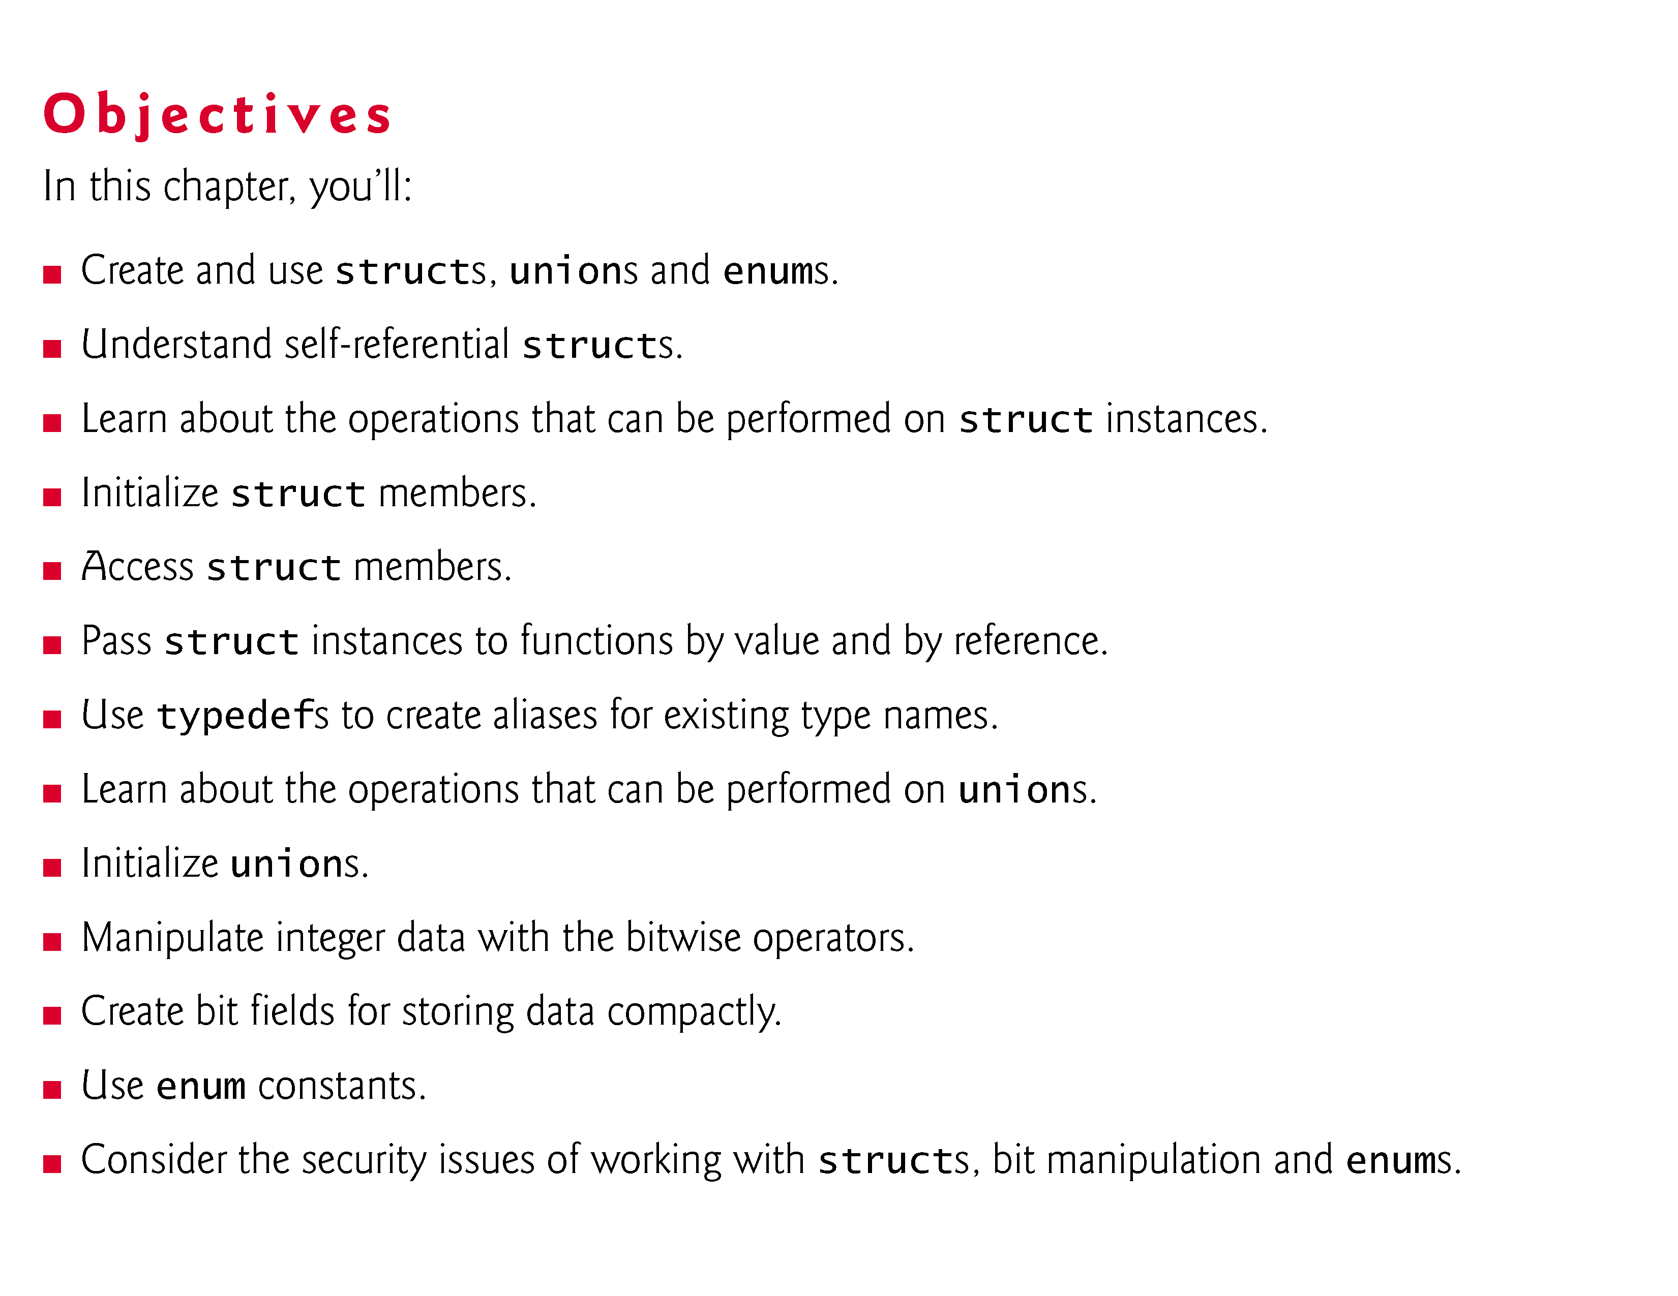

Slide 3
Introduction
Structures
Collections of related variables (aggregates) under one name
Can contain variables of different data types
Commonly used to define records to be stored in files
Combined with pointers, can create linked lists, stacks, queues, and trees

Slide 4
We’ll also discuss:
typedefs—for creating aliases for previously defined data types
unions—derived data types like structures, but with members that share the same storage space
bitwise operators—for manipulating the bits of integral operands
bit fields—unsigned int or int members of structures or unions for which you specify the number of bits in which the members are stored, helping you pack information tightly
enumerations—sets of integer constants represented by identifiers.

Slide 5
Structure Definitions
Structures are derived data types—they’re constructed using objects of other types
Example
struct card {
char *face;
char *suit; };
struct introduces the definition for structure card
card is the structure tag name and is used to declare variables of the structure type
card contains two members of type char *
These members are face and suit

Slide 6
Structure Definitions
struct information
A struct cannot contain an instance of itself
Can contain a member that is a pointer to the same structure type
A structure definition does not reserve space in memory
Instead creates a new data type used to define structure variables
Definitions
Defined like other variables:
card oneCard, deck[ 52 ], *cPtr;
Can use a comma separated list:
struct card {
char *face;
char *suit;
} oneCard, deck[ 52 ], *cPtr;

Slide 7
Structure Definitions
For example, the following struct contains character array members for an employee’s first and last names, an unsigned int member for the employee’s age, a char member that would contain 'M' or 'F' for the employee’s gender and a double member for the employee’s hourly salary:,
struct employee { char firstName[20]; char lastName[20]; unsigned int age; char gender; double hourlySalary; };

Slide 8
Structure Tag Names
The structure tag name is optional.
If a structure definition does not contain a structure tag name, variables of the structure type may be declared only in the structure definition—not in a separate declaration.

Slide 9
Self-Referential Structures
A structure cannot contain an instance of itself.
For example, a variable of type struct employee cannot be declared in the definition for struct employee.
A pointer to struct employee, however, may be included.
For example,
struct employee2 { char firstName[20]; char lastName[20]; unsigned int age; char gender; double hourlySalary; struct employee2 person; // ERROR struct employee2 *ePtr; // pointer };
struct employee2 contains an instance of itself (person), which is an error.

Slide 10
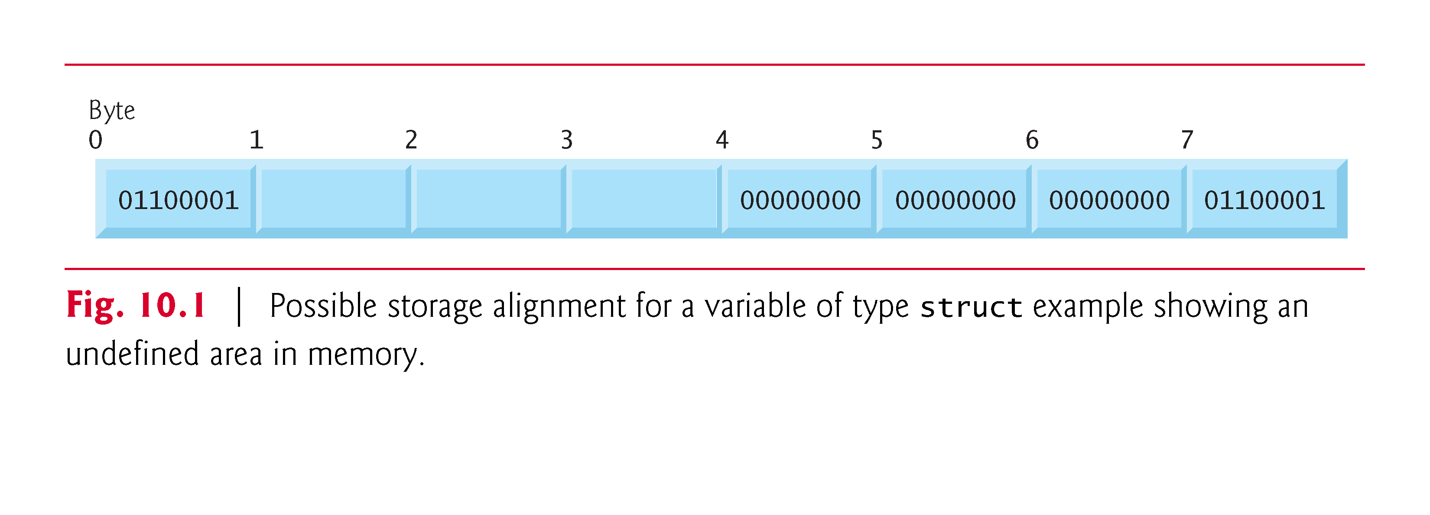
It shows a sample storage alignment for a variable of type struct example that has been assigned the character 'a' and the integer 97 (the bit representations of the values are shown).
If the members are stored beginning at word boundaries, there’s a 1-byte hole (byte 1 in the figure) in the storage for variables of type struct example.
The value in the 1-byte hole is undefined.
Even if the member values of sample1 and sample2 are in fact equal, the structures are not necessarily equal, because the undefined 1-byte holes are not likely to contain identical values.

Slide 11
Structure’s Valid Operations
The only valid operations that may be performed on structures are:
assigning structure variables to structure variables of the same type,
taking the address (&) of a structure variable,
accessing the members of a structure variable (see Section 10.4) and
using the sizeof operator to determine the size of a structure variable.
Structures may not be compared using operators == and !=, because structure members are not necessarily stored in consecutive bytes of memory.

Slide 12
Initializing Structures
Initializer lists
Example:
card oneCard = { "Three", "Hearts" };
Assignment statements
Example:
card threeHearts = oneCard;
Could also define and initialize threeHearts as follows:
card threeHearts;
threeHearts.face = “Three”;
threeHearts.suit = “Hearts”;

Slide 13
Accessing Members of Structures
Accessing structure members
Dot operator (.) used with structure variables
card myCard;
printf( "%s", myCard.suit );
Arrow operator (->) used with pointers to structure variables
card *myCardPtr = &myCard;
printf( "%s", myCardPtr->suit );
myCardPtr->suit is equivalent to
( *myCardPtr ).suit

Slide 14
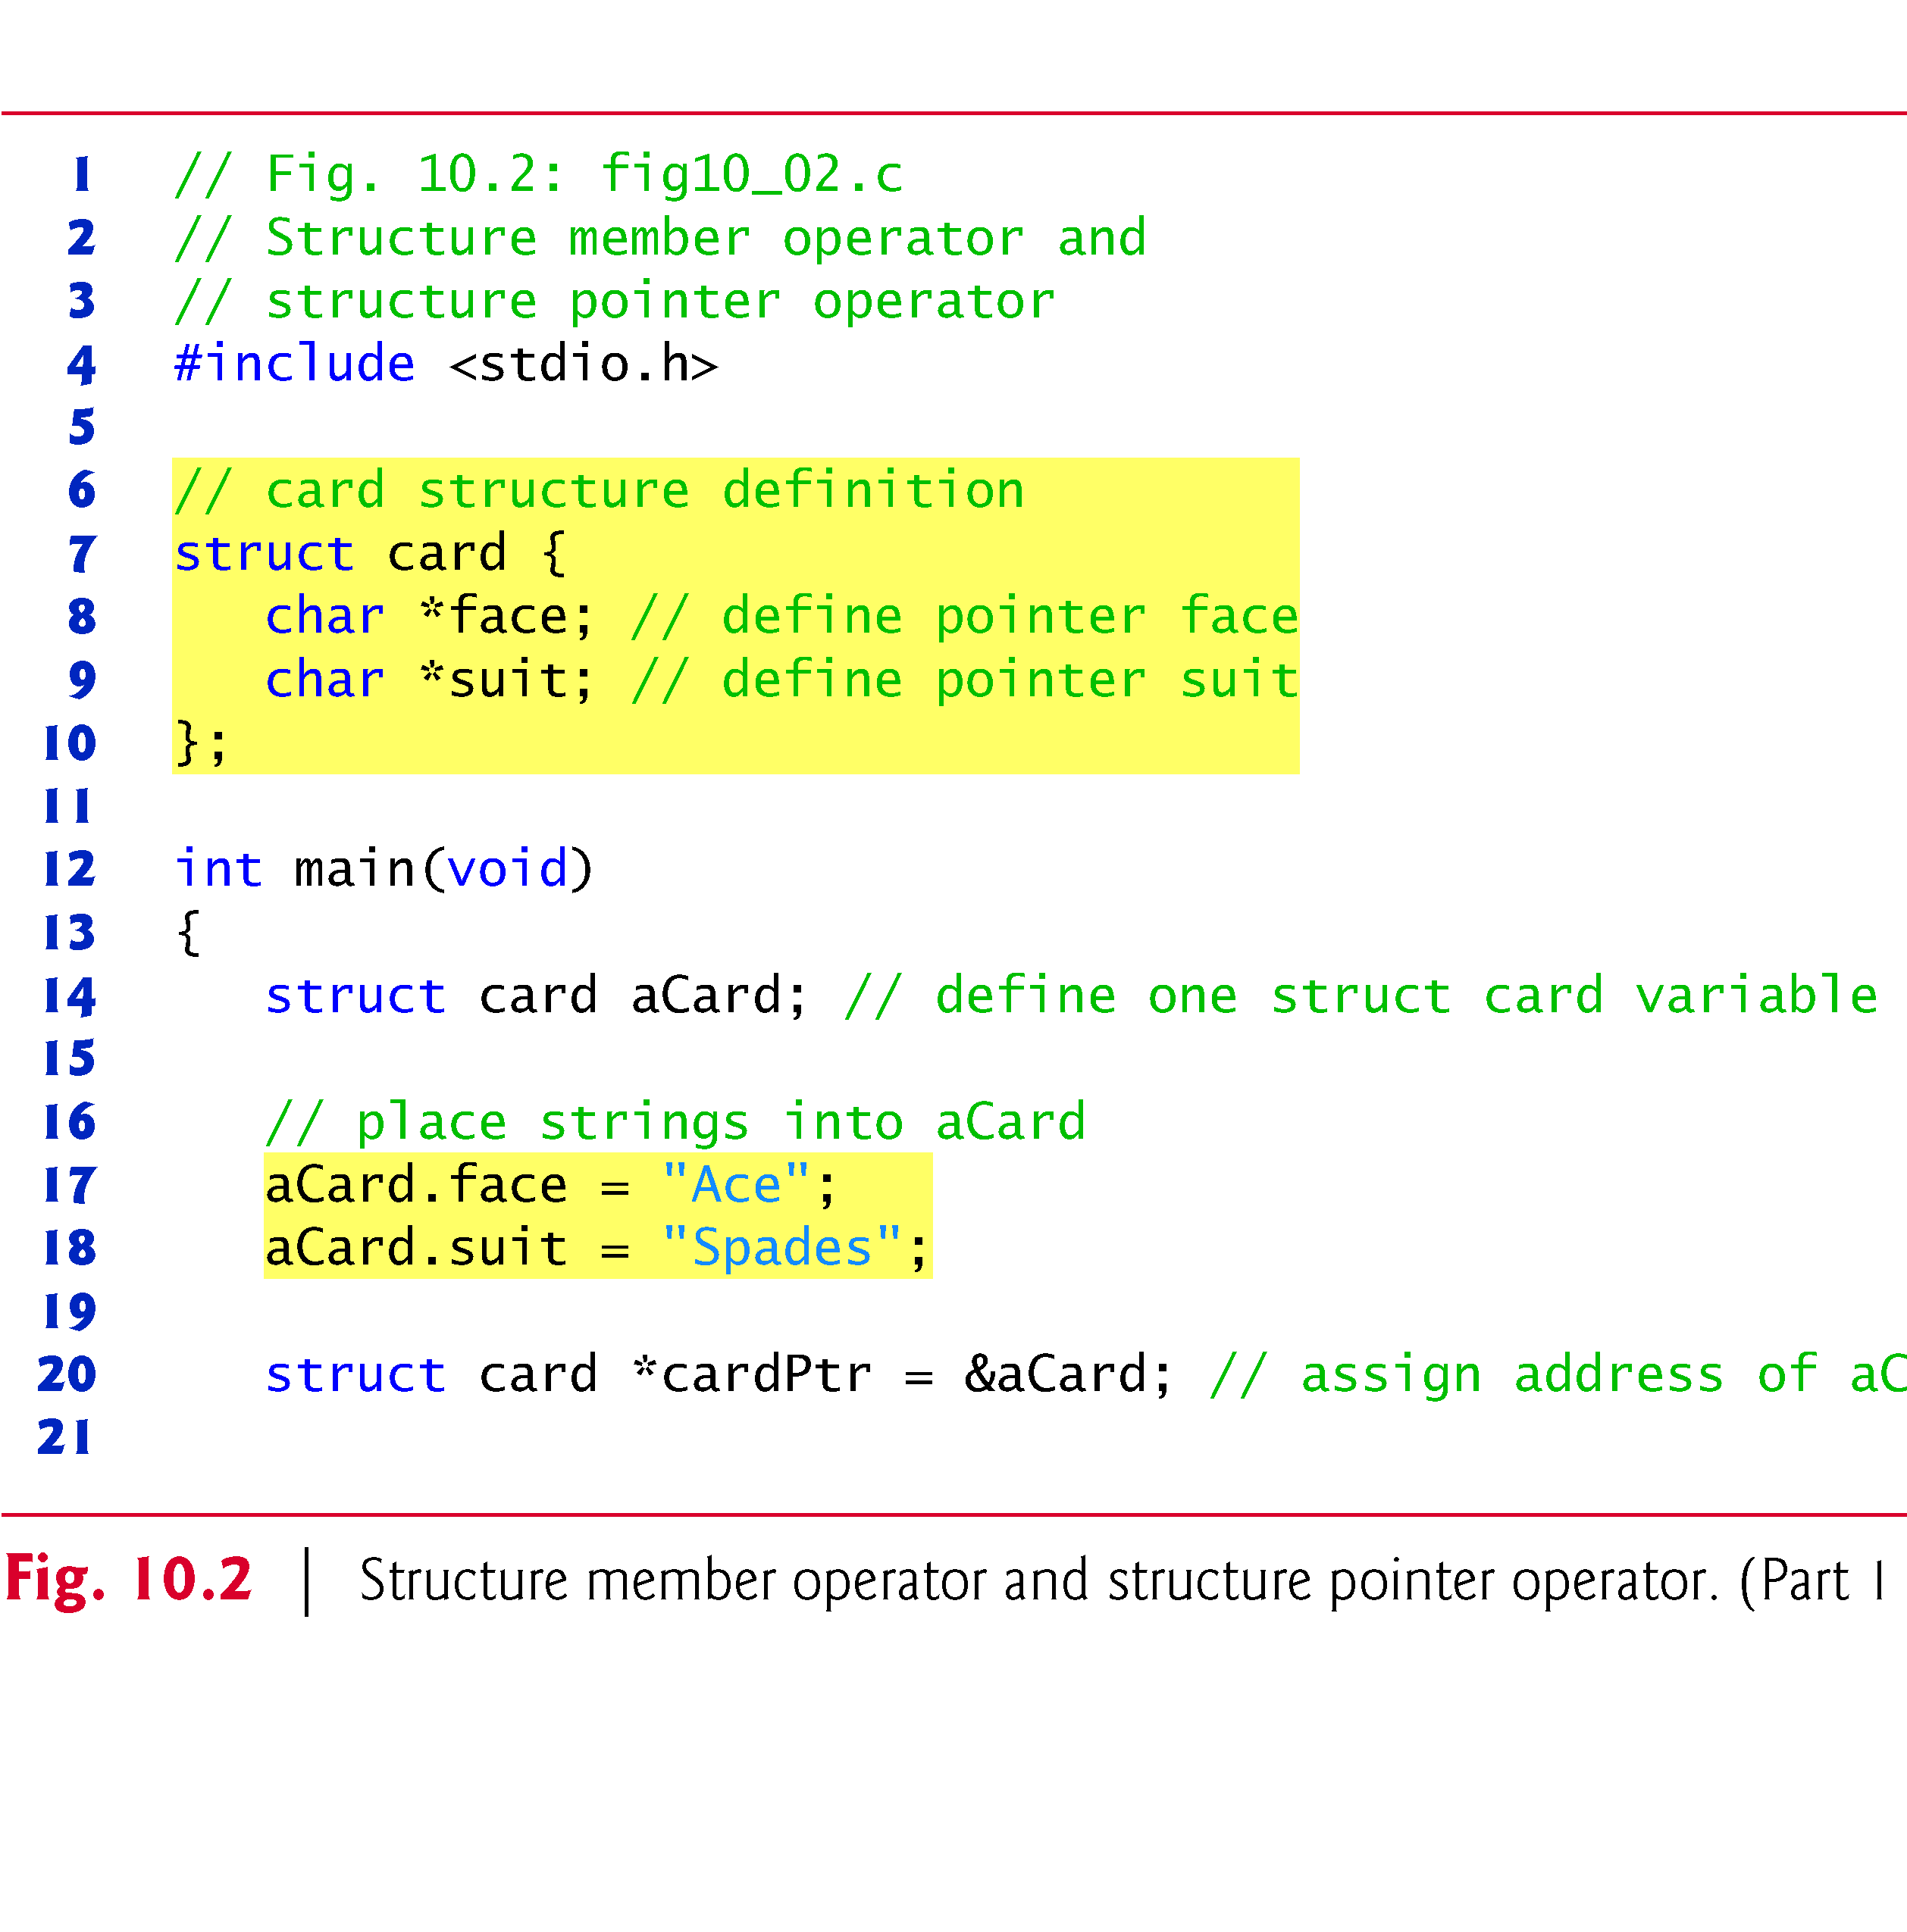
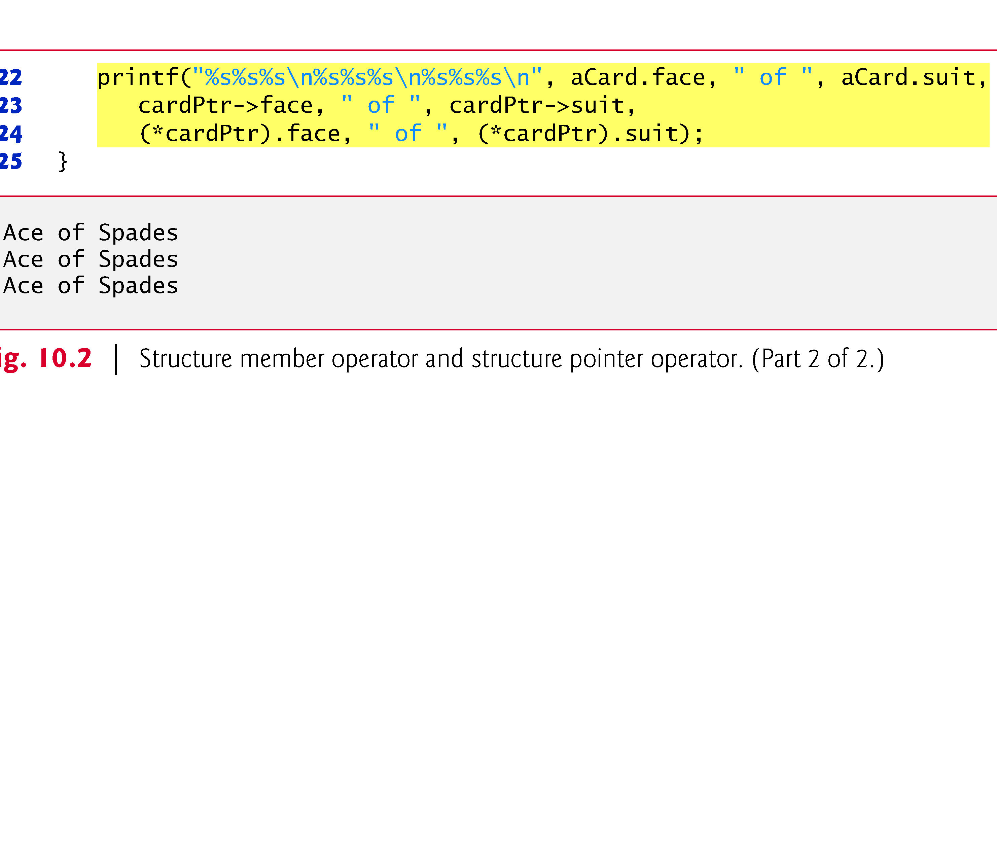

Slide 15
Using Structures With Functions
Passing structures to functions
Pass entire structure
Or, pass individual members
Both pass call by value
To pass structures call-by-reference
Pass its address
Pass reference to it
To pass arrays call-by-value
Create a structure with the array as a member
Pass the structure

Slide 16
typedef
typedef
Creates synonyms (aliases) for previously defined data types
Use typedef to create shorter type names
Example:
typedef struct Card *CardPtr;
Defines a new type name CardPtr as a synonym for type struct Card *
typedef does not create a new data type
Only creates an alias

Slide 17
Example: High-Performance Card-shuffling and Dealing Simulation
Pseudocode:
Create an array of card structures
Put cards in the deck
Shuffle the deck
Deal the cards

Slide 18
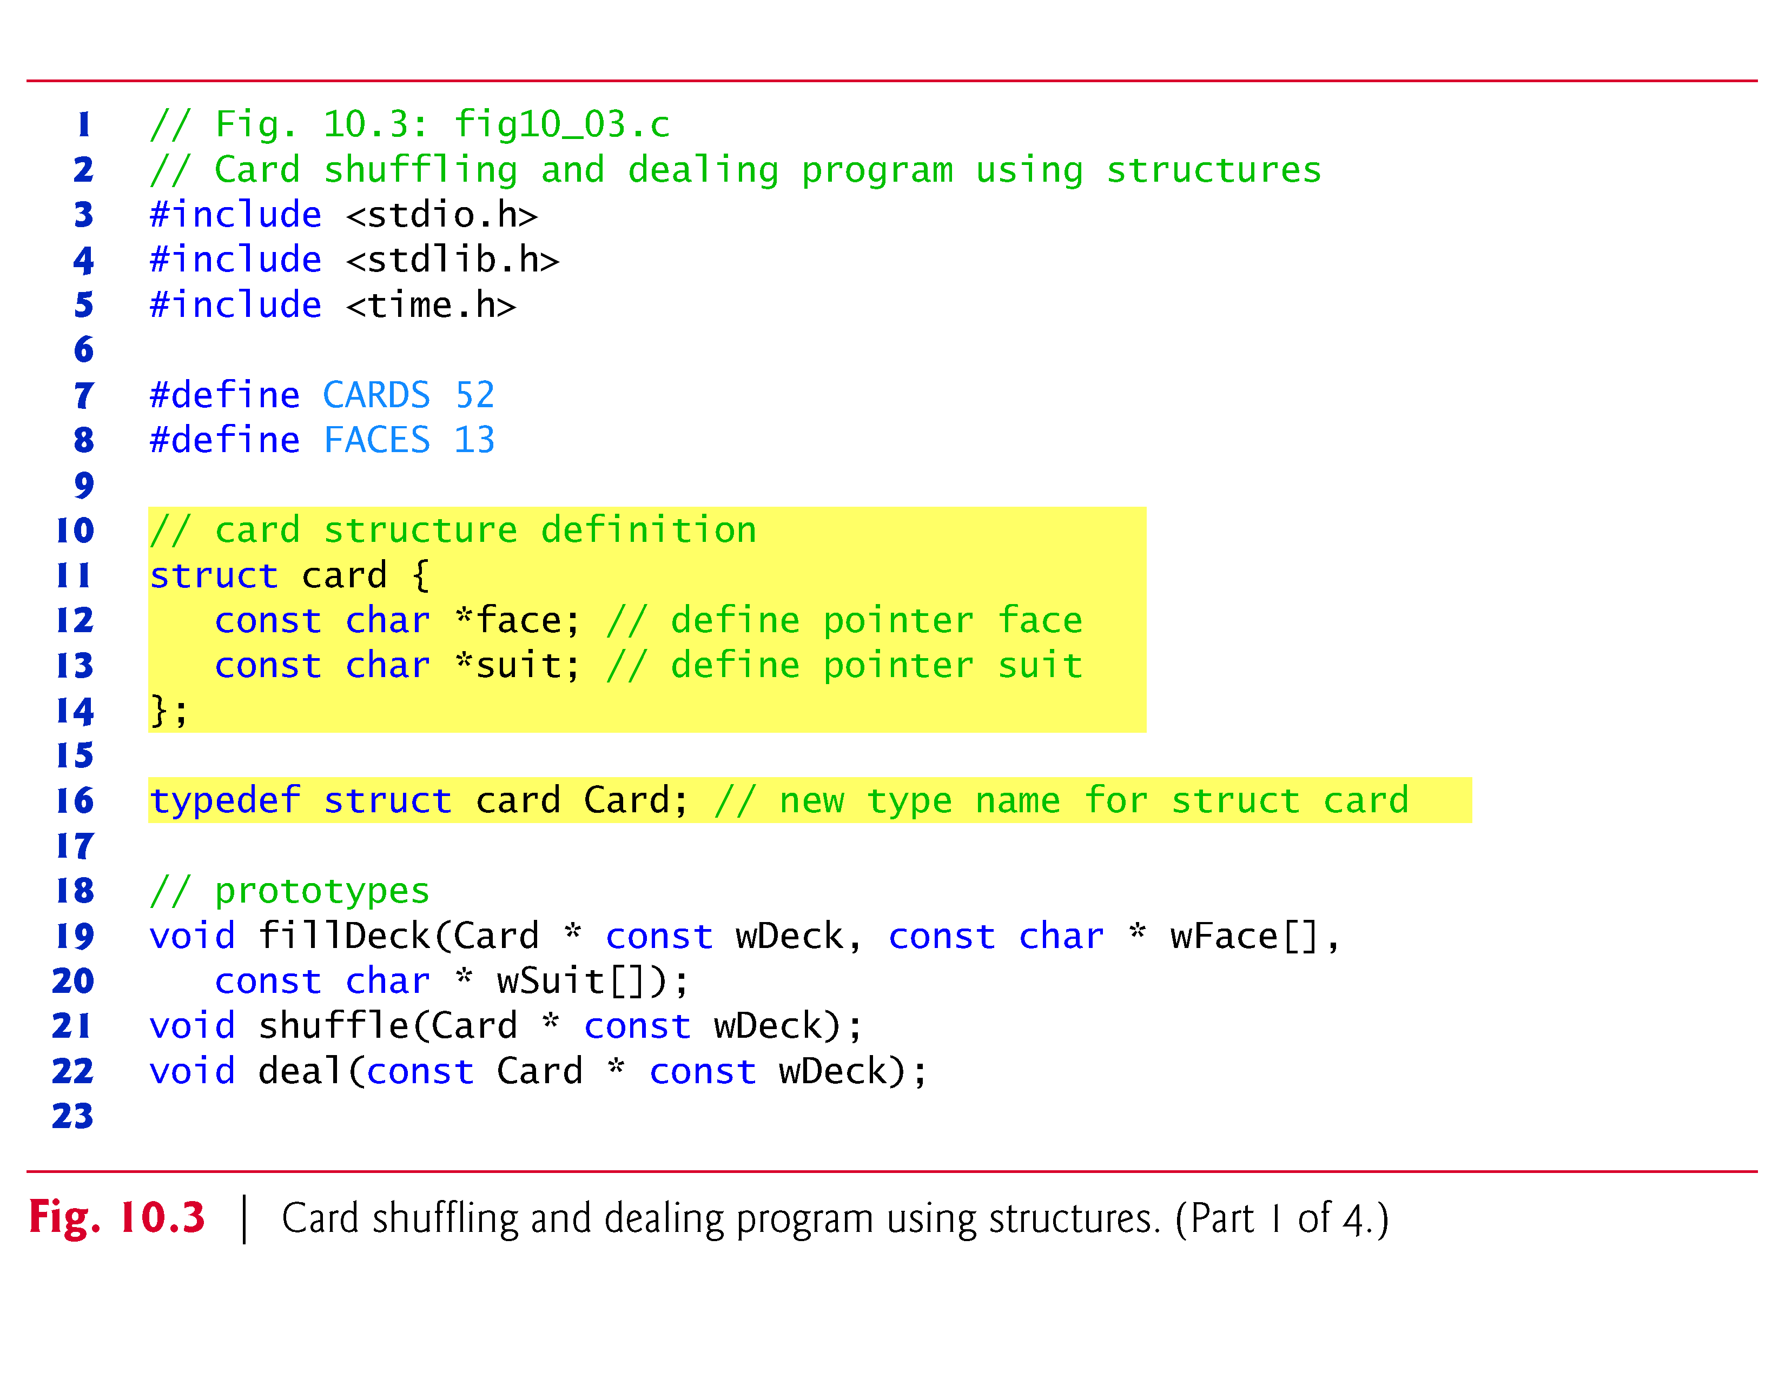

Slide 19
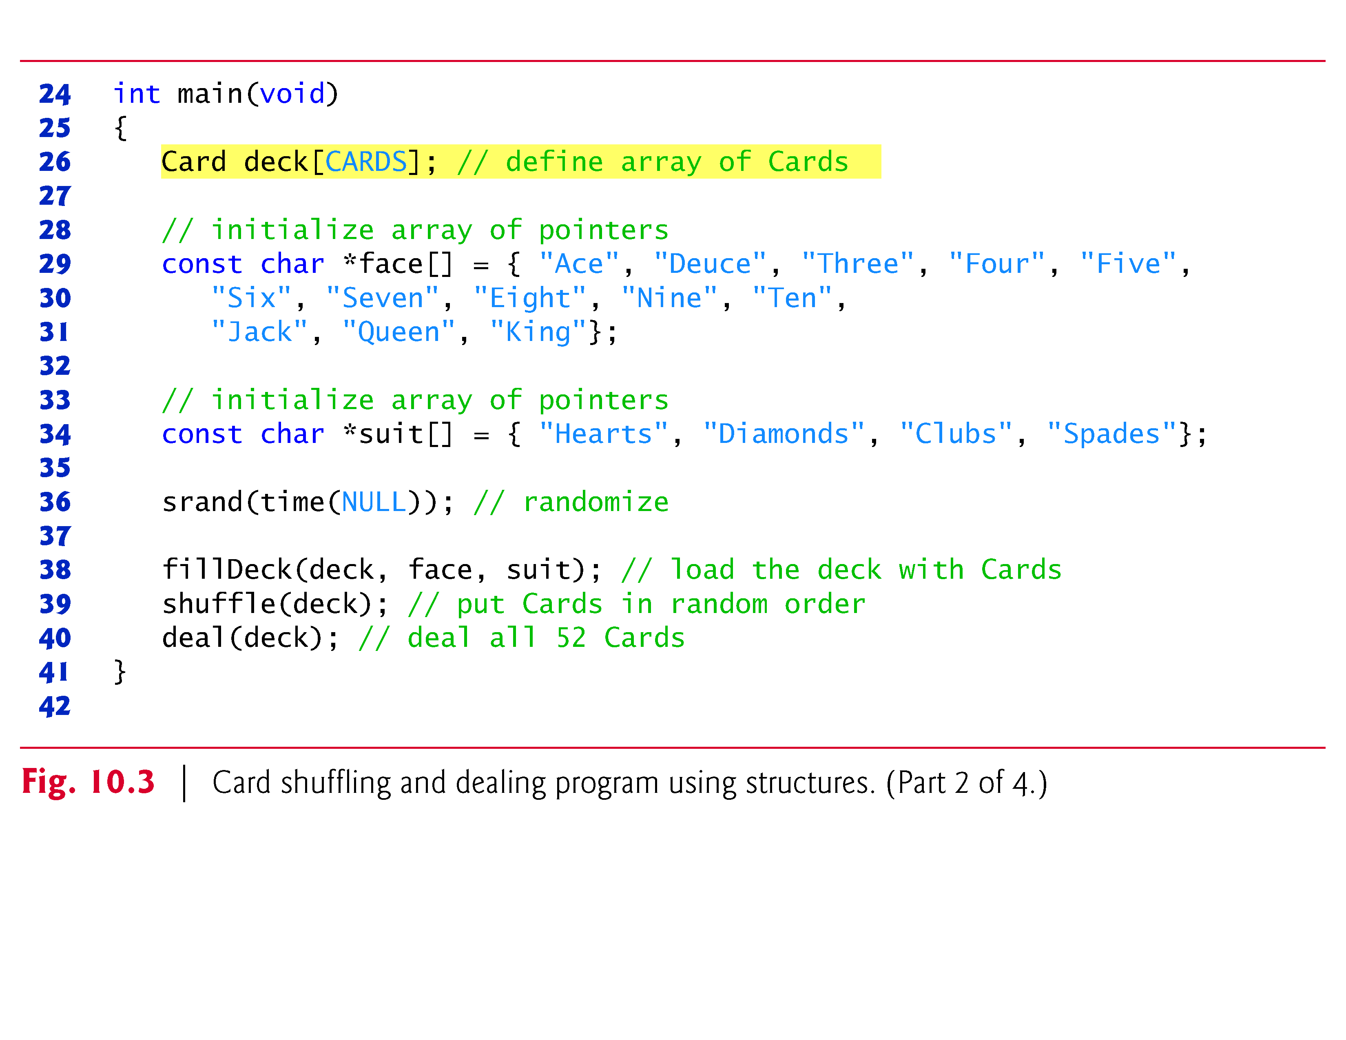

Slide 20
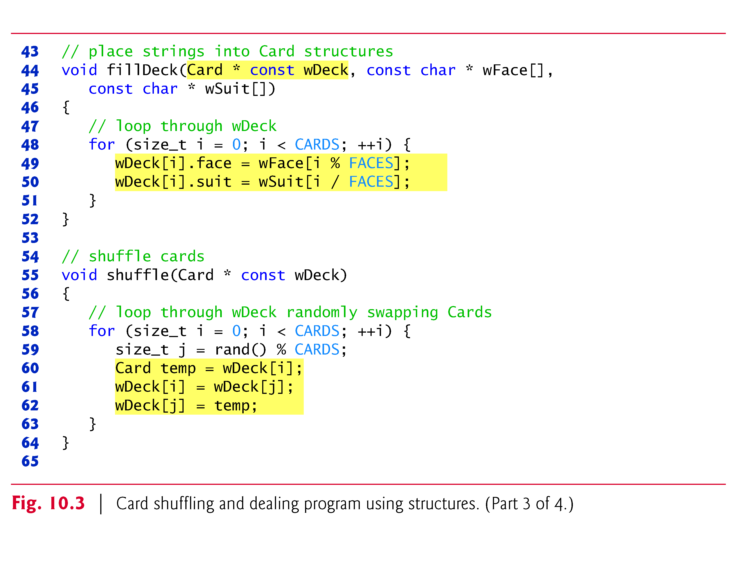

Slide 21
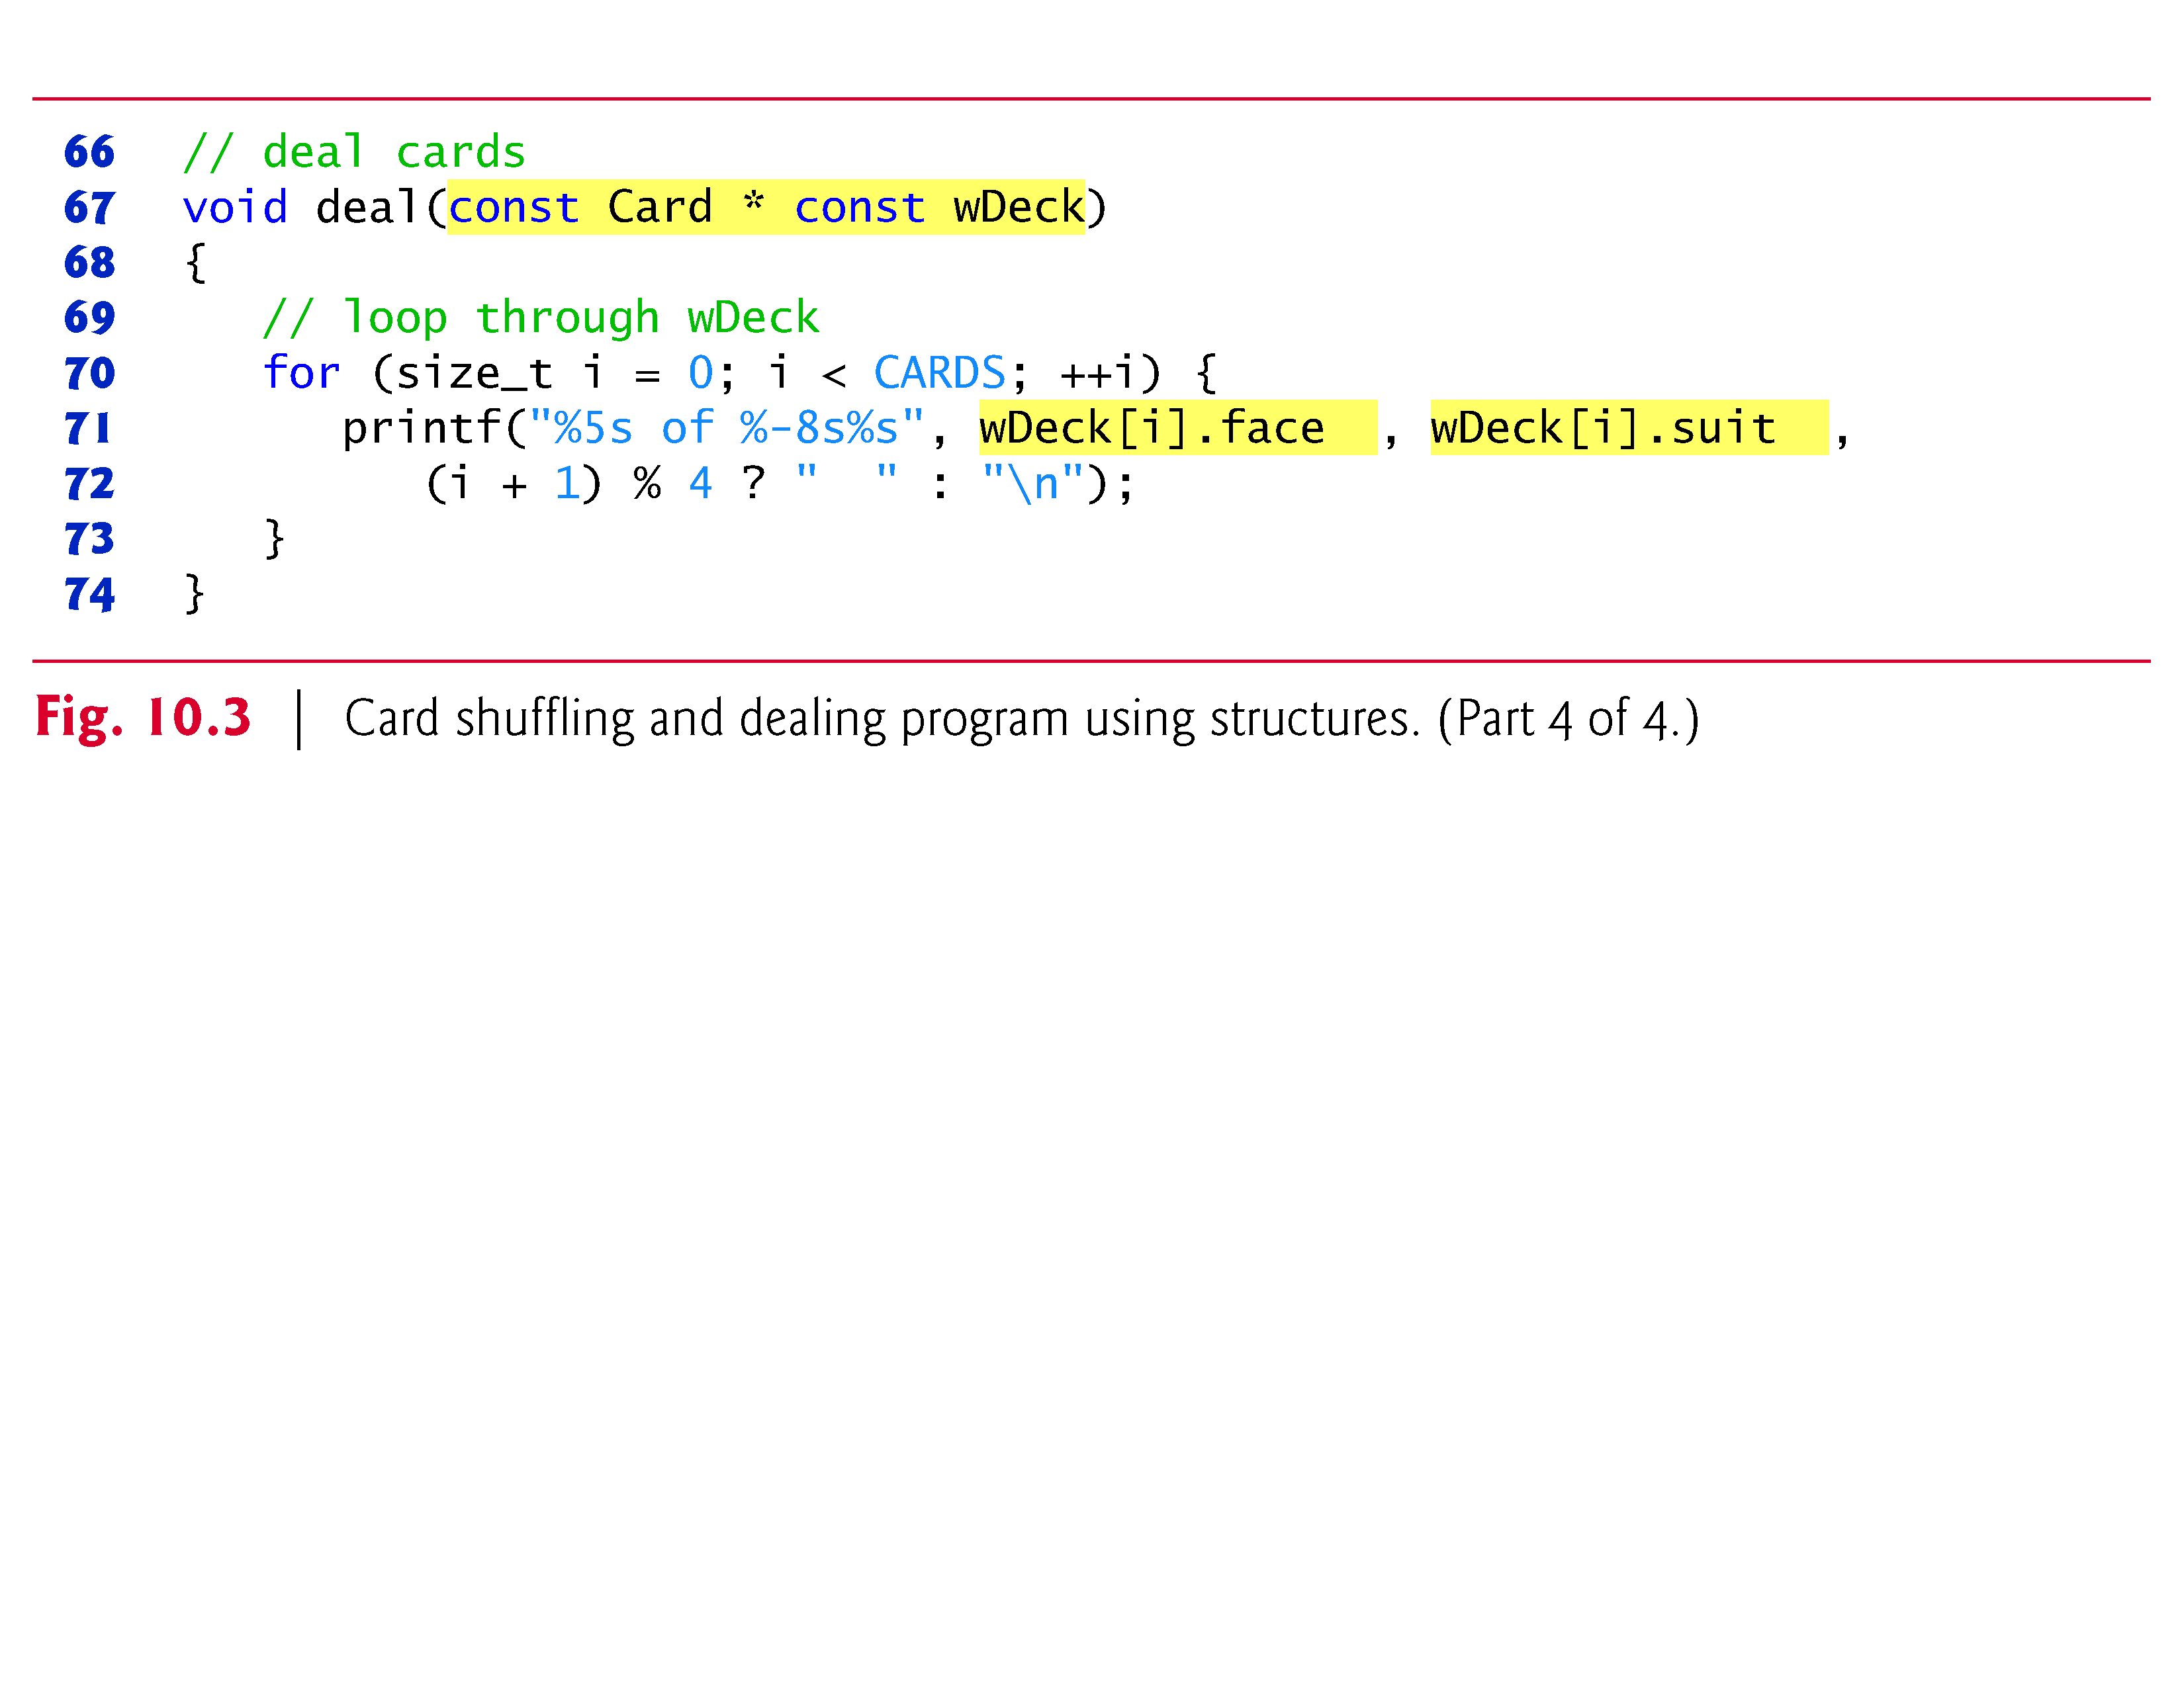

Slide 22
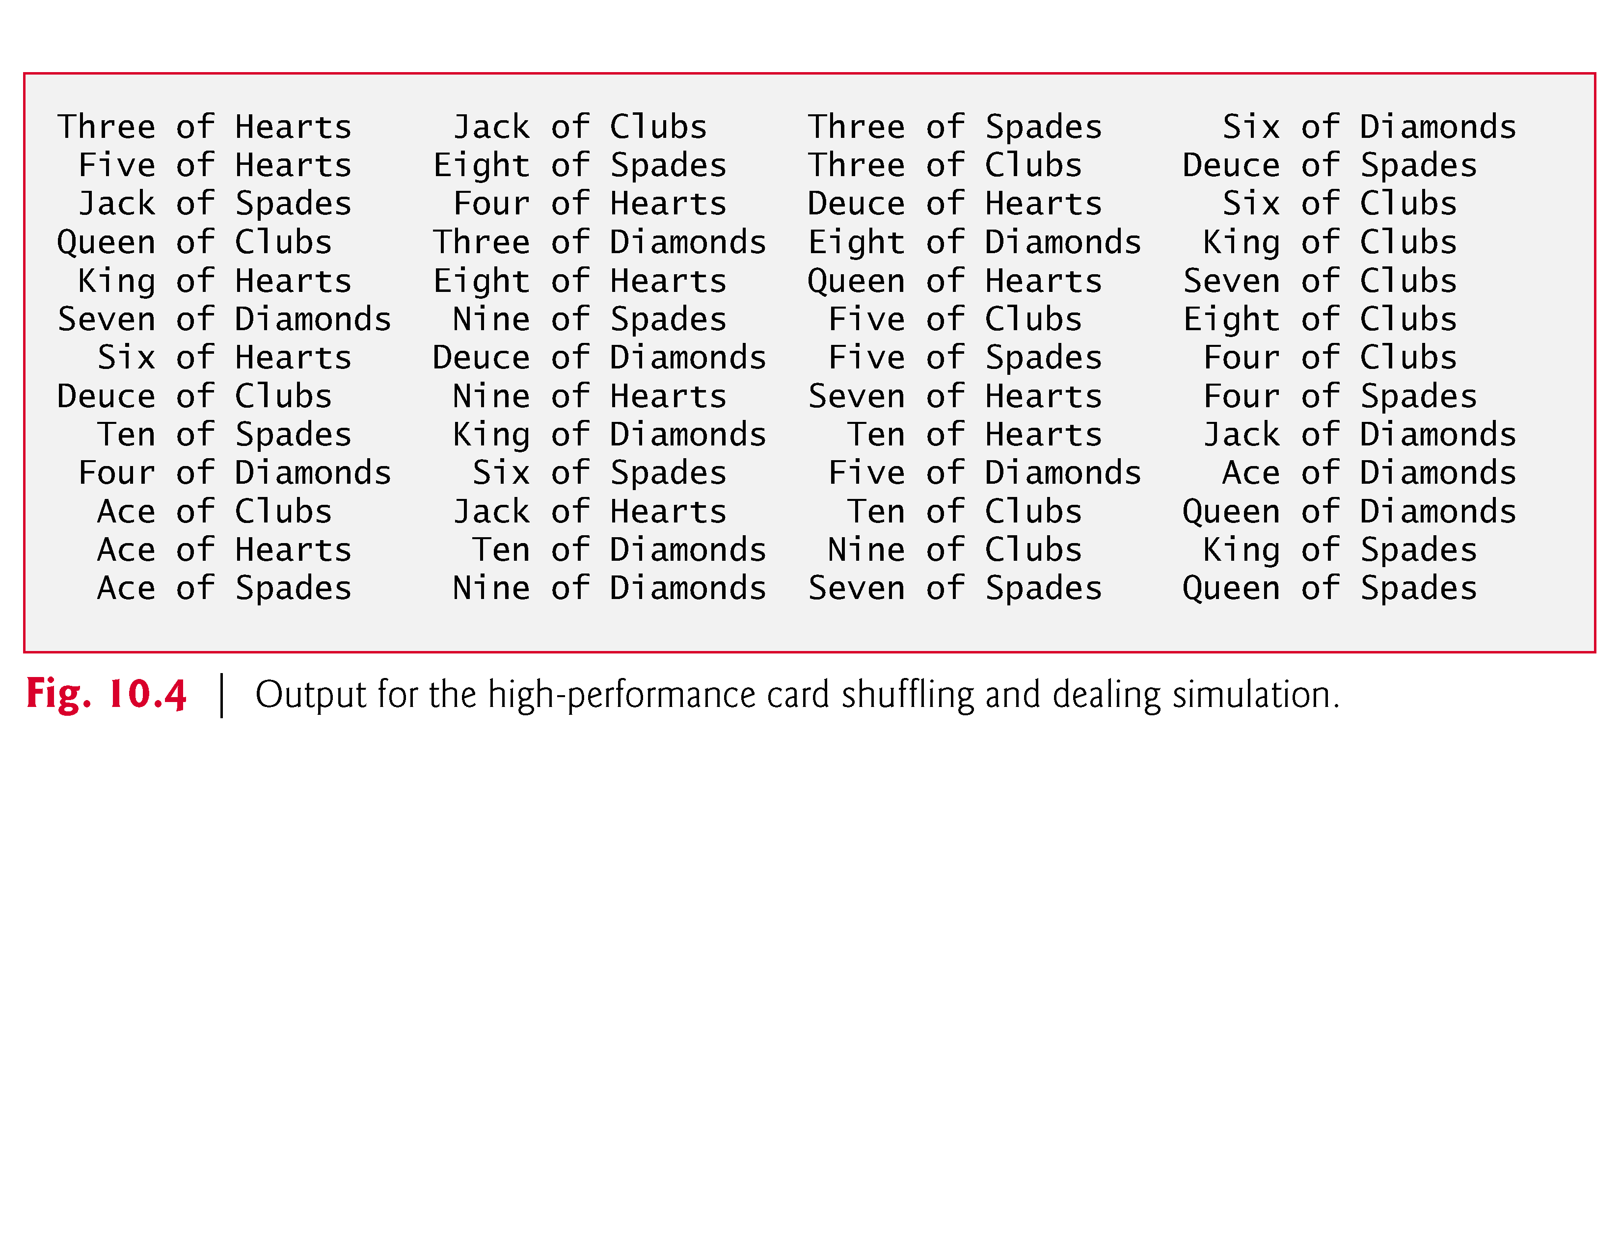

Slide 23
Unions
union
Memory that contains a variety of objects over time
Only contains one data member at a time
Members of a union share space
Conserves storage
Only the last data member defined can be accessed
union definitions
Same as struct
union Number {
int x;
float y;
};
union Number value;

Slide 24
Unions
Valid union operations
Assignment to union of same type: =
Taking address: &
Accessing union members: .
Accessing members using pointers: ->

Slide 25
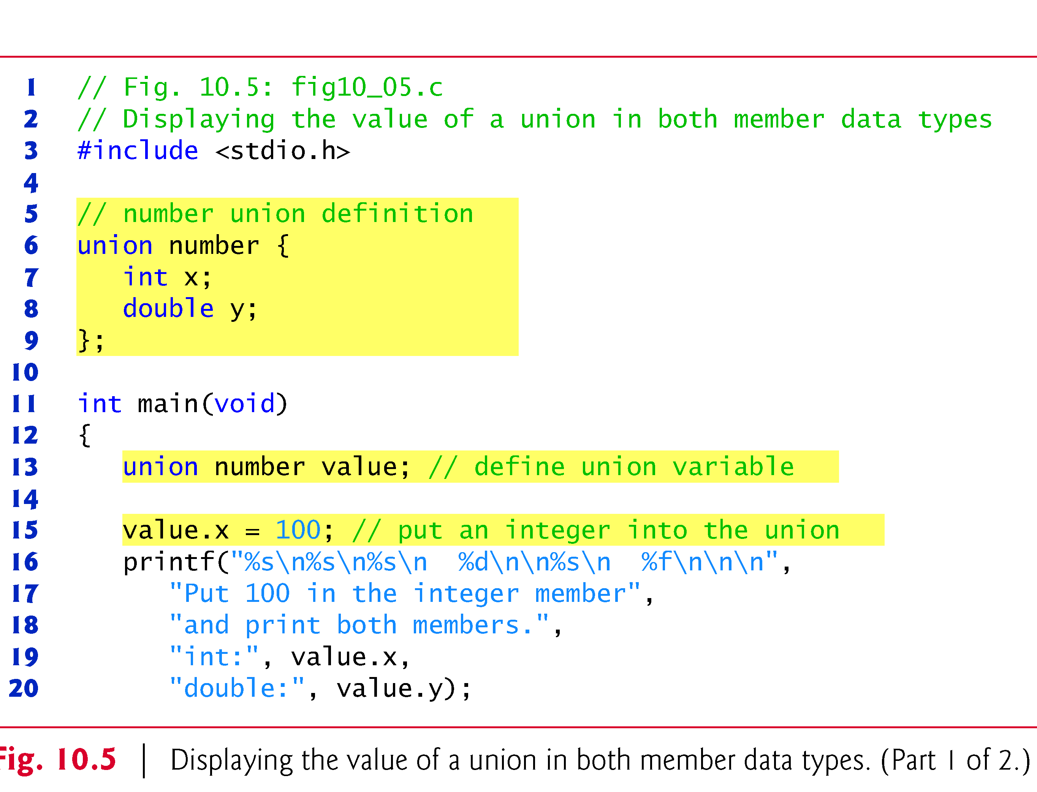
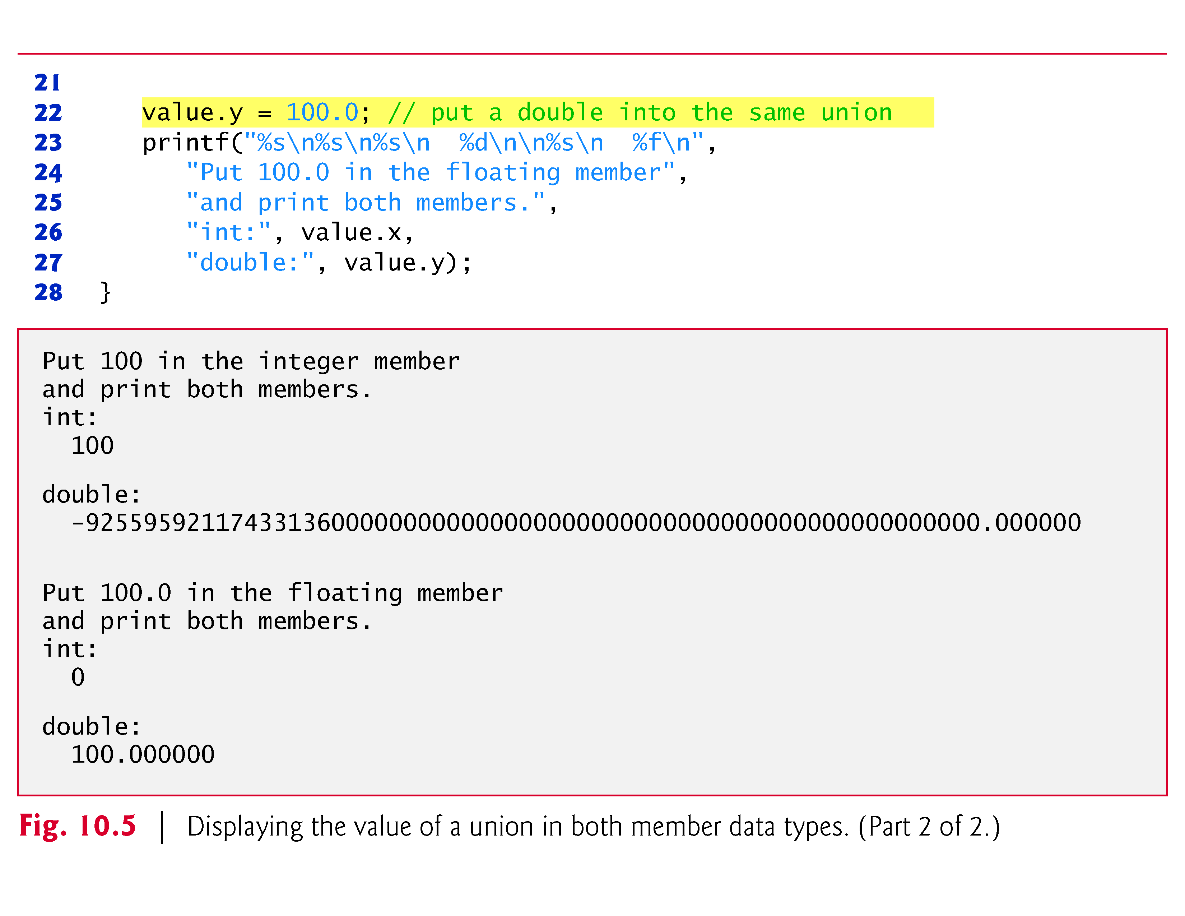

Slide 26
Bitwise Operators
All data represented internally as sequences of bits
Each bit can be either 0 or 1
Sequence of 8 bits forms a byte

Slide 27
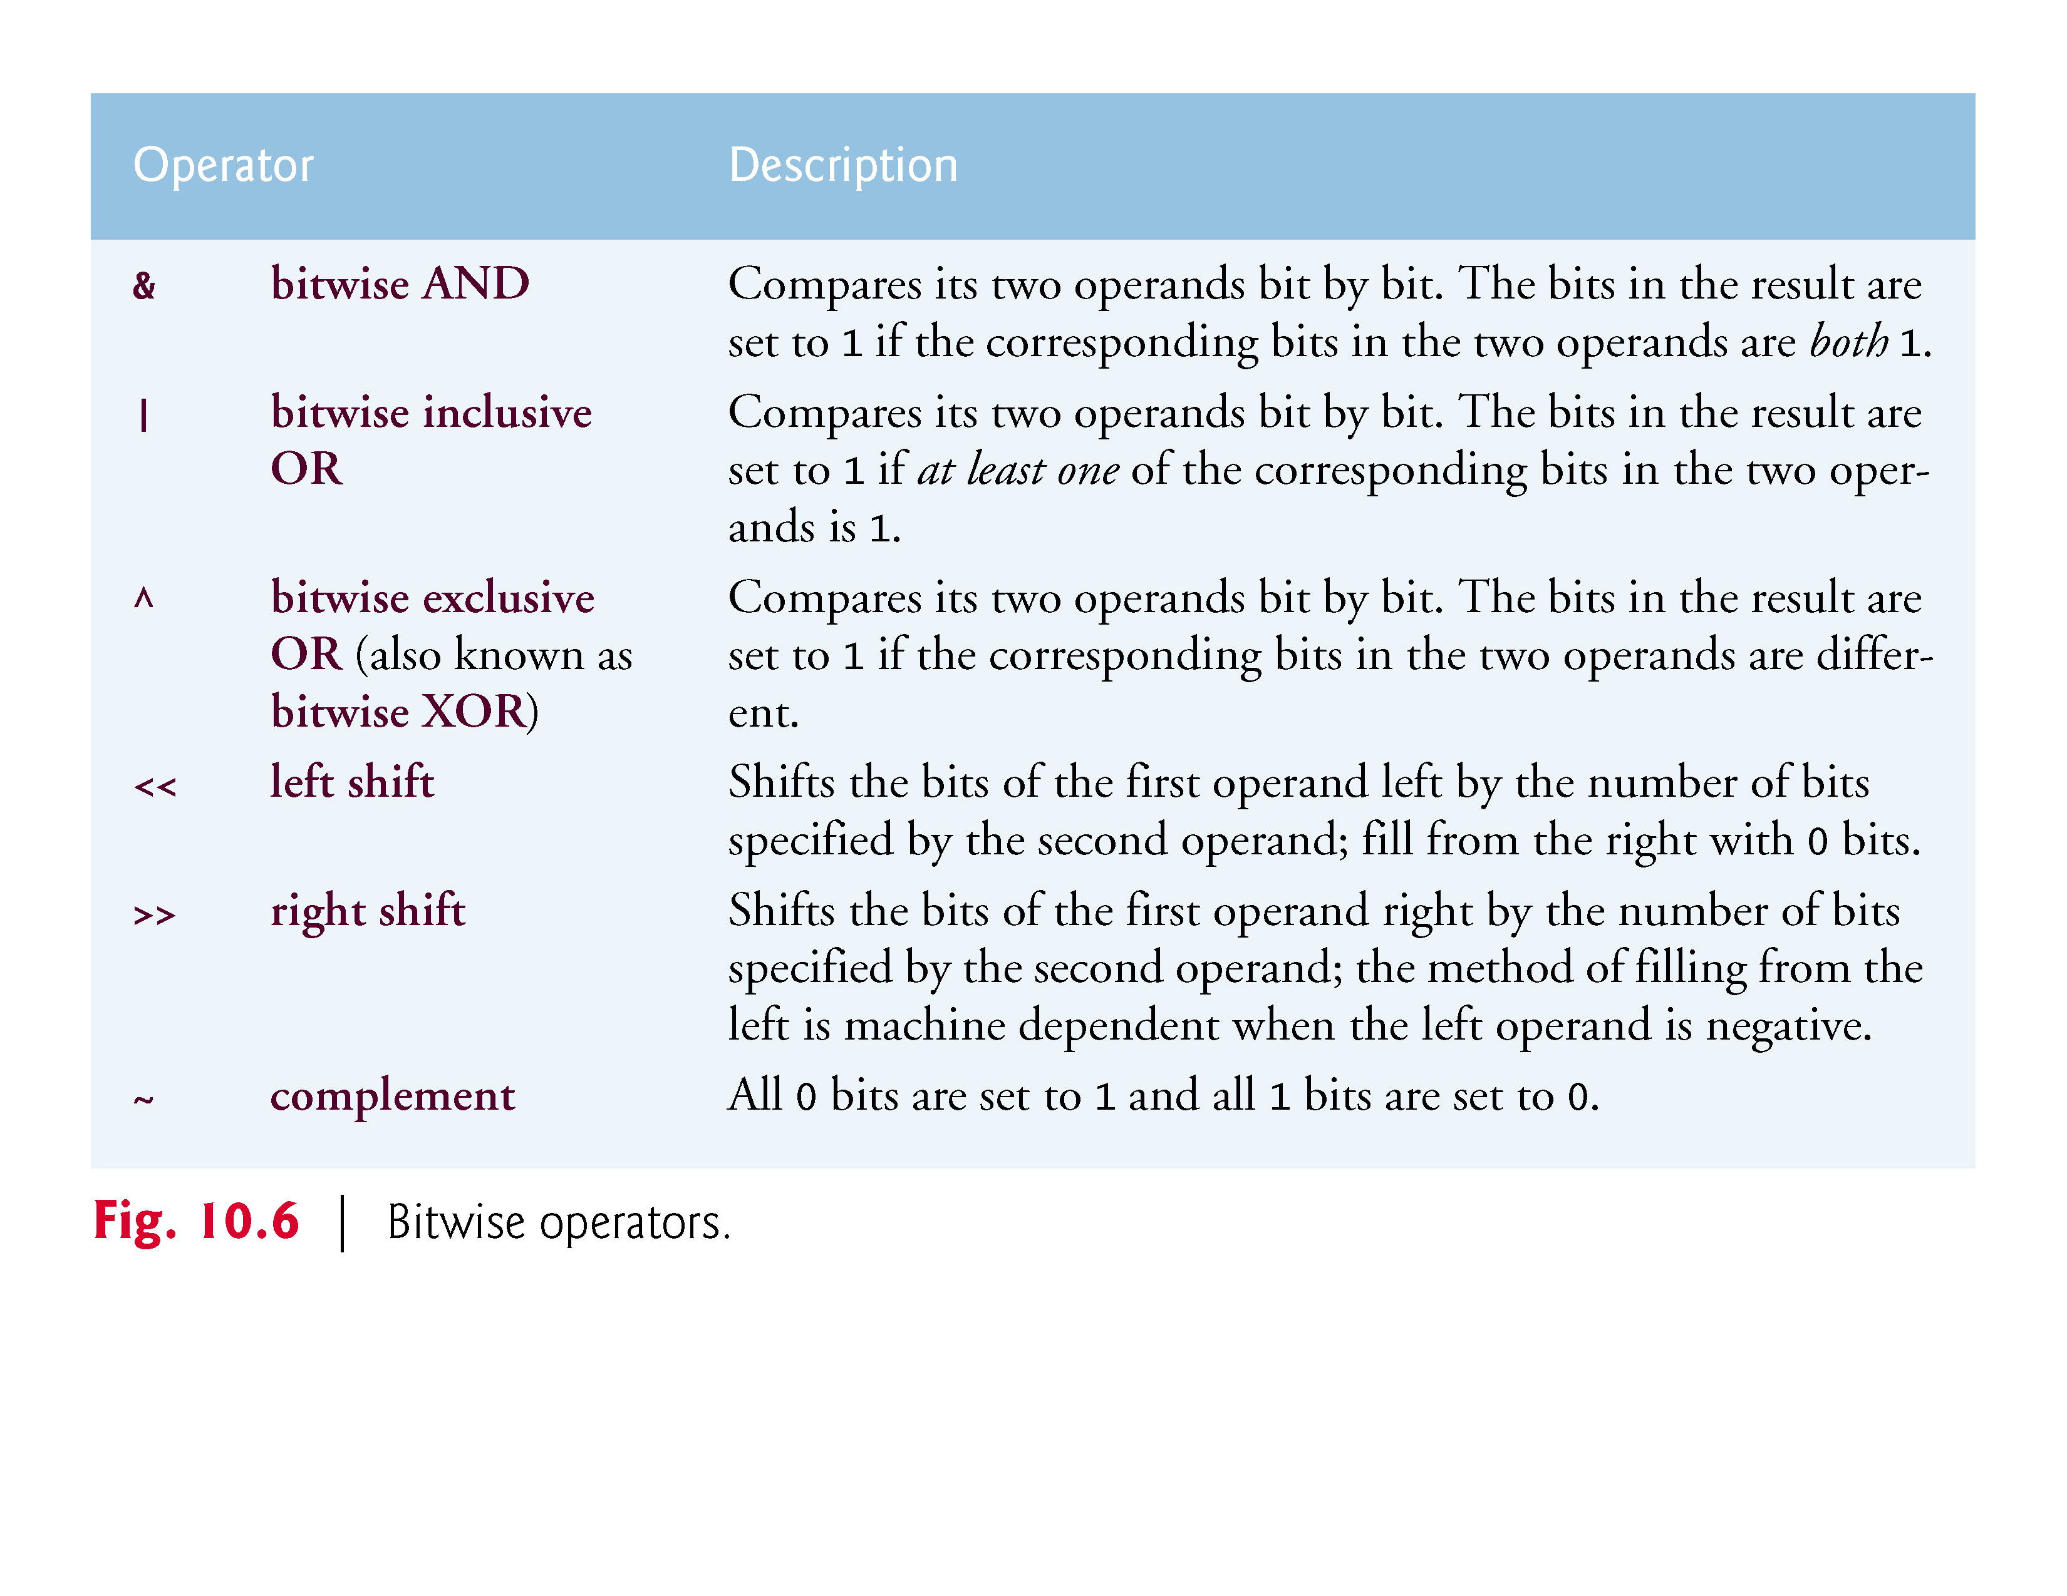

Slide 28
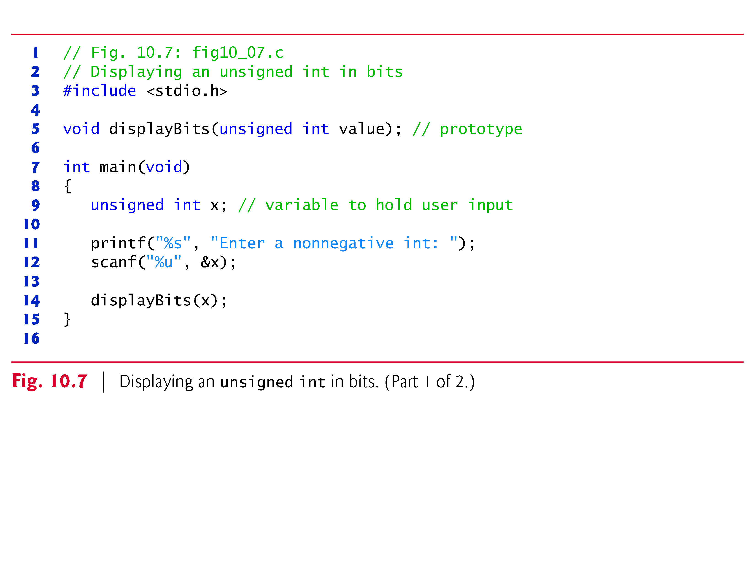
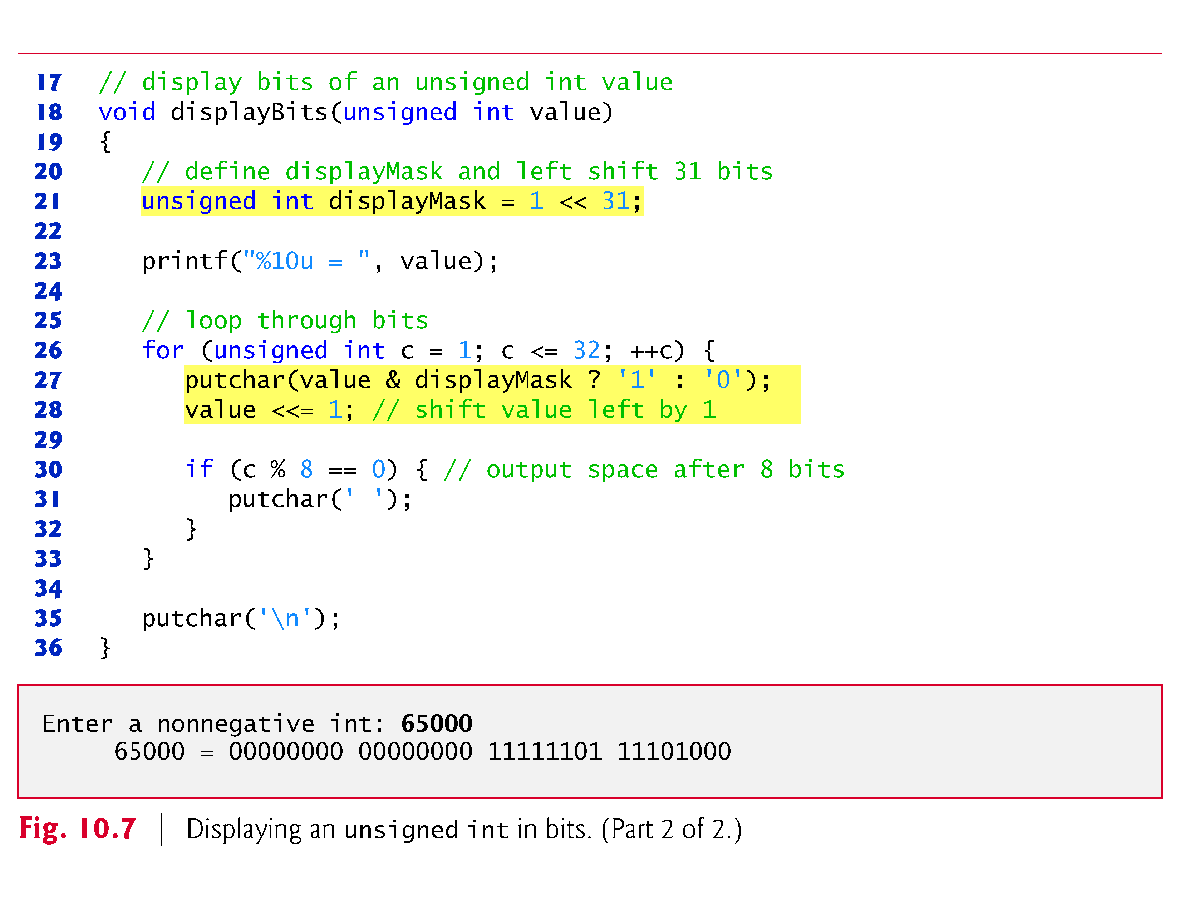

Slide 29
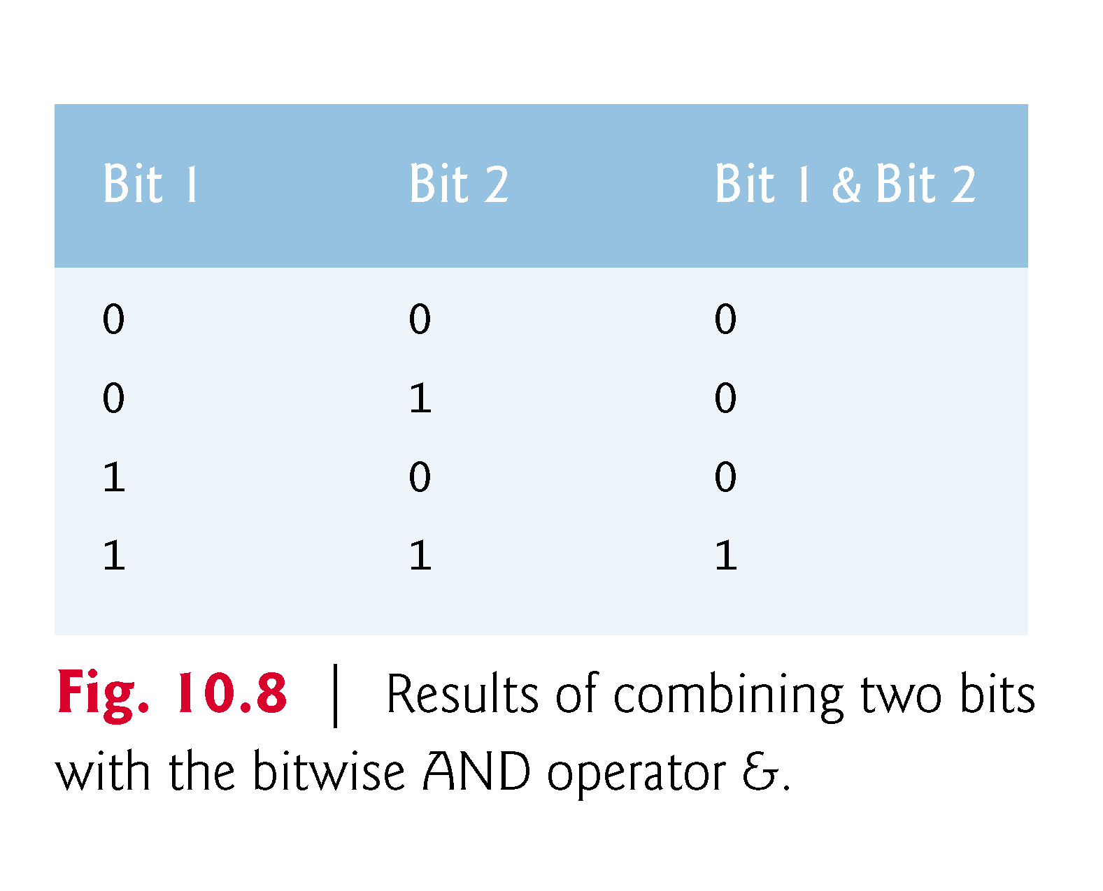
Bitwise Operators

Slide 30
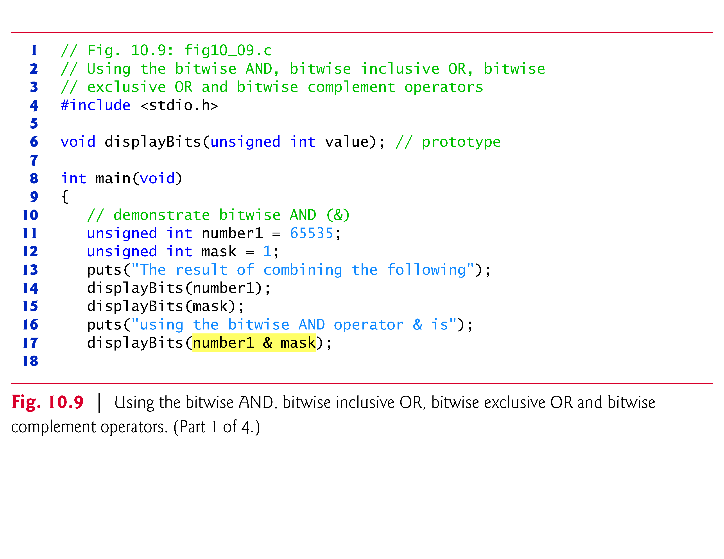

Slide 31
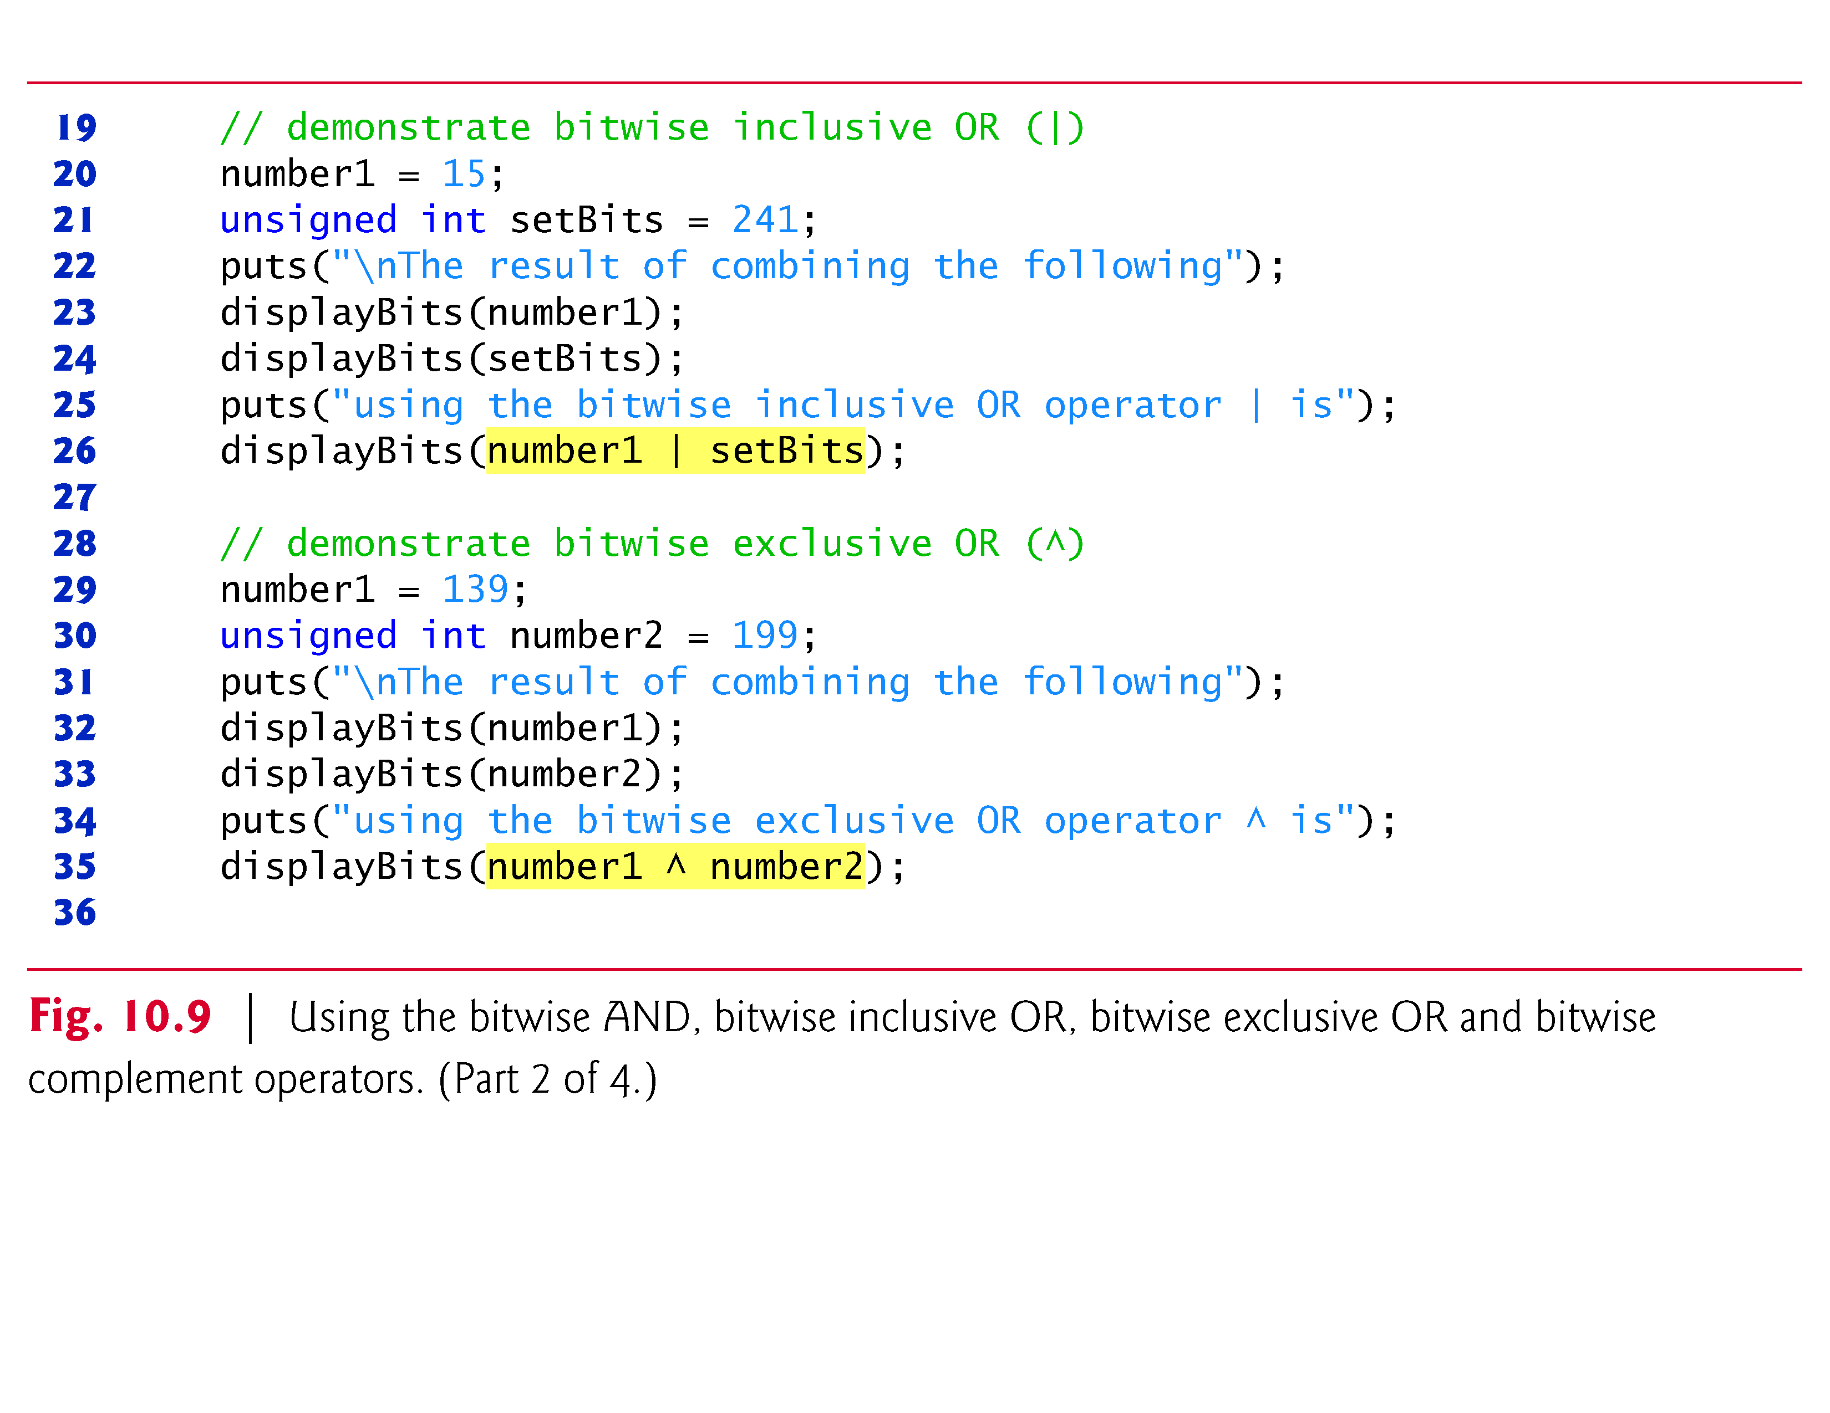
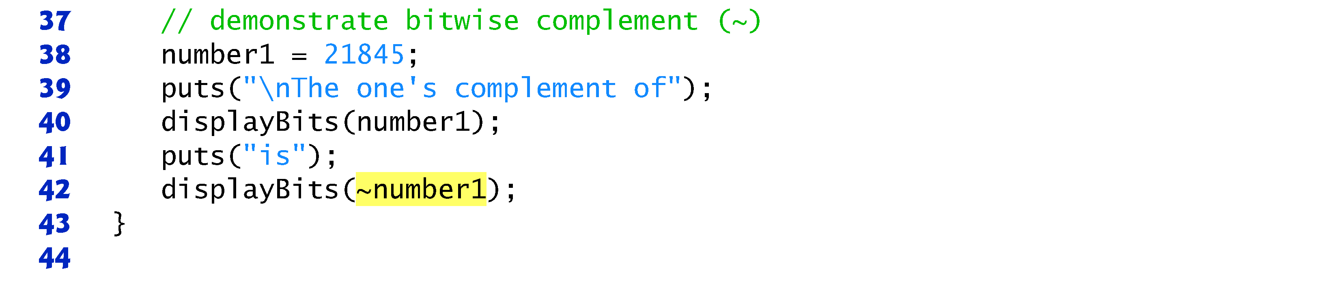

Slide 32
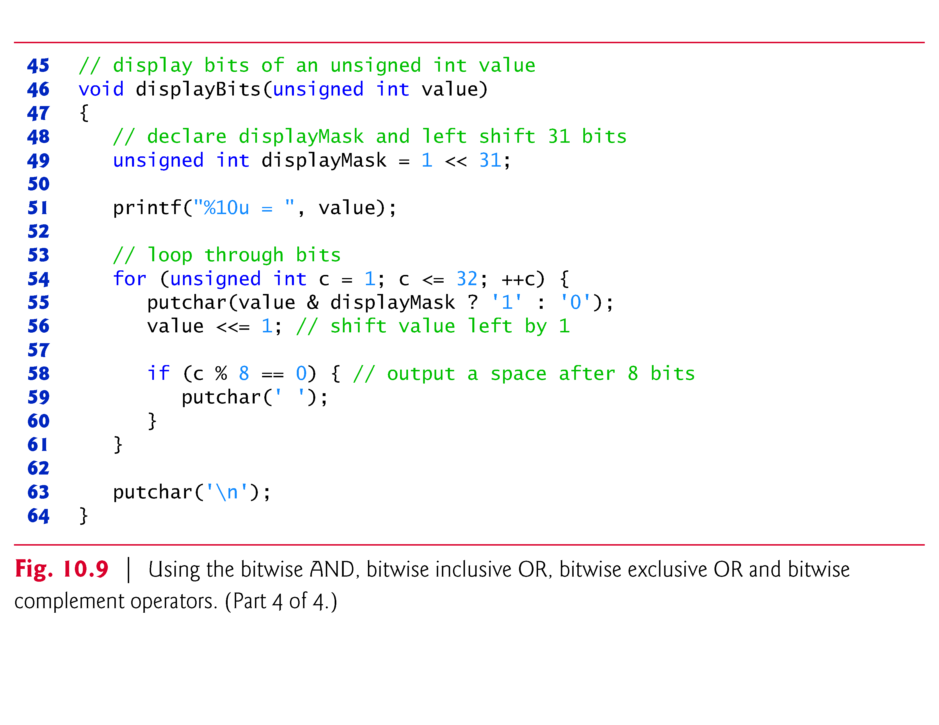

Slide 33
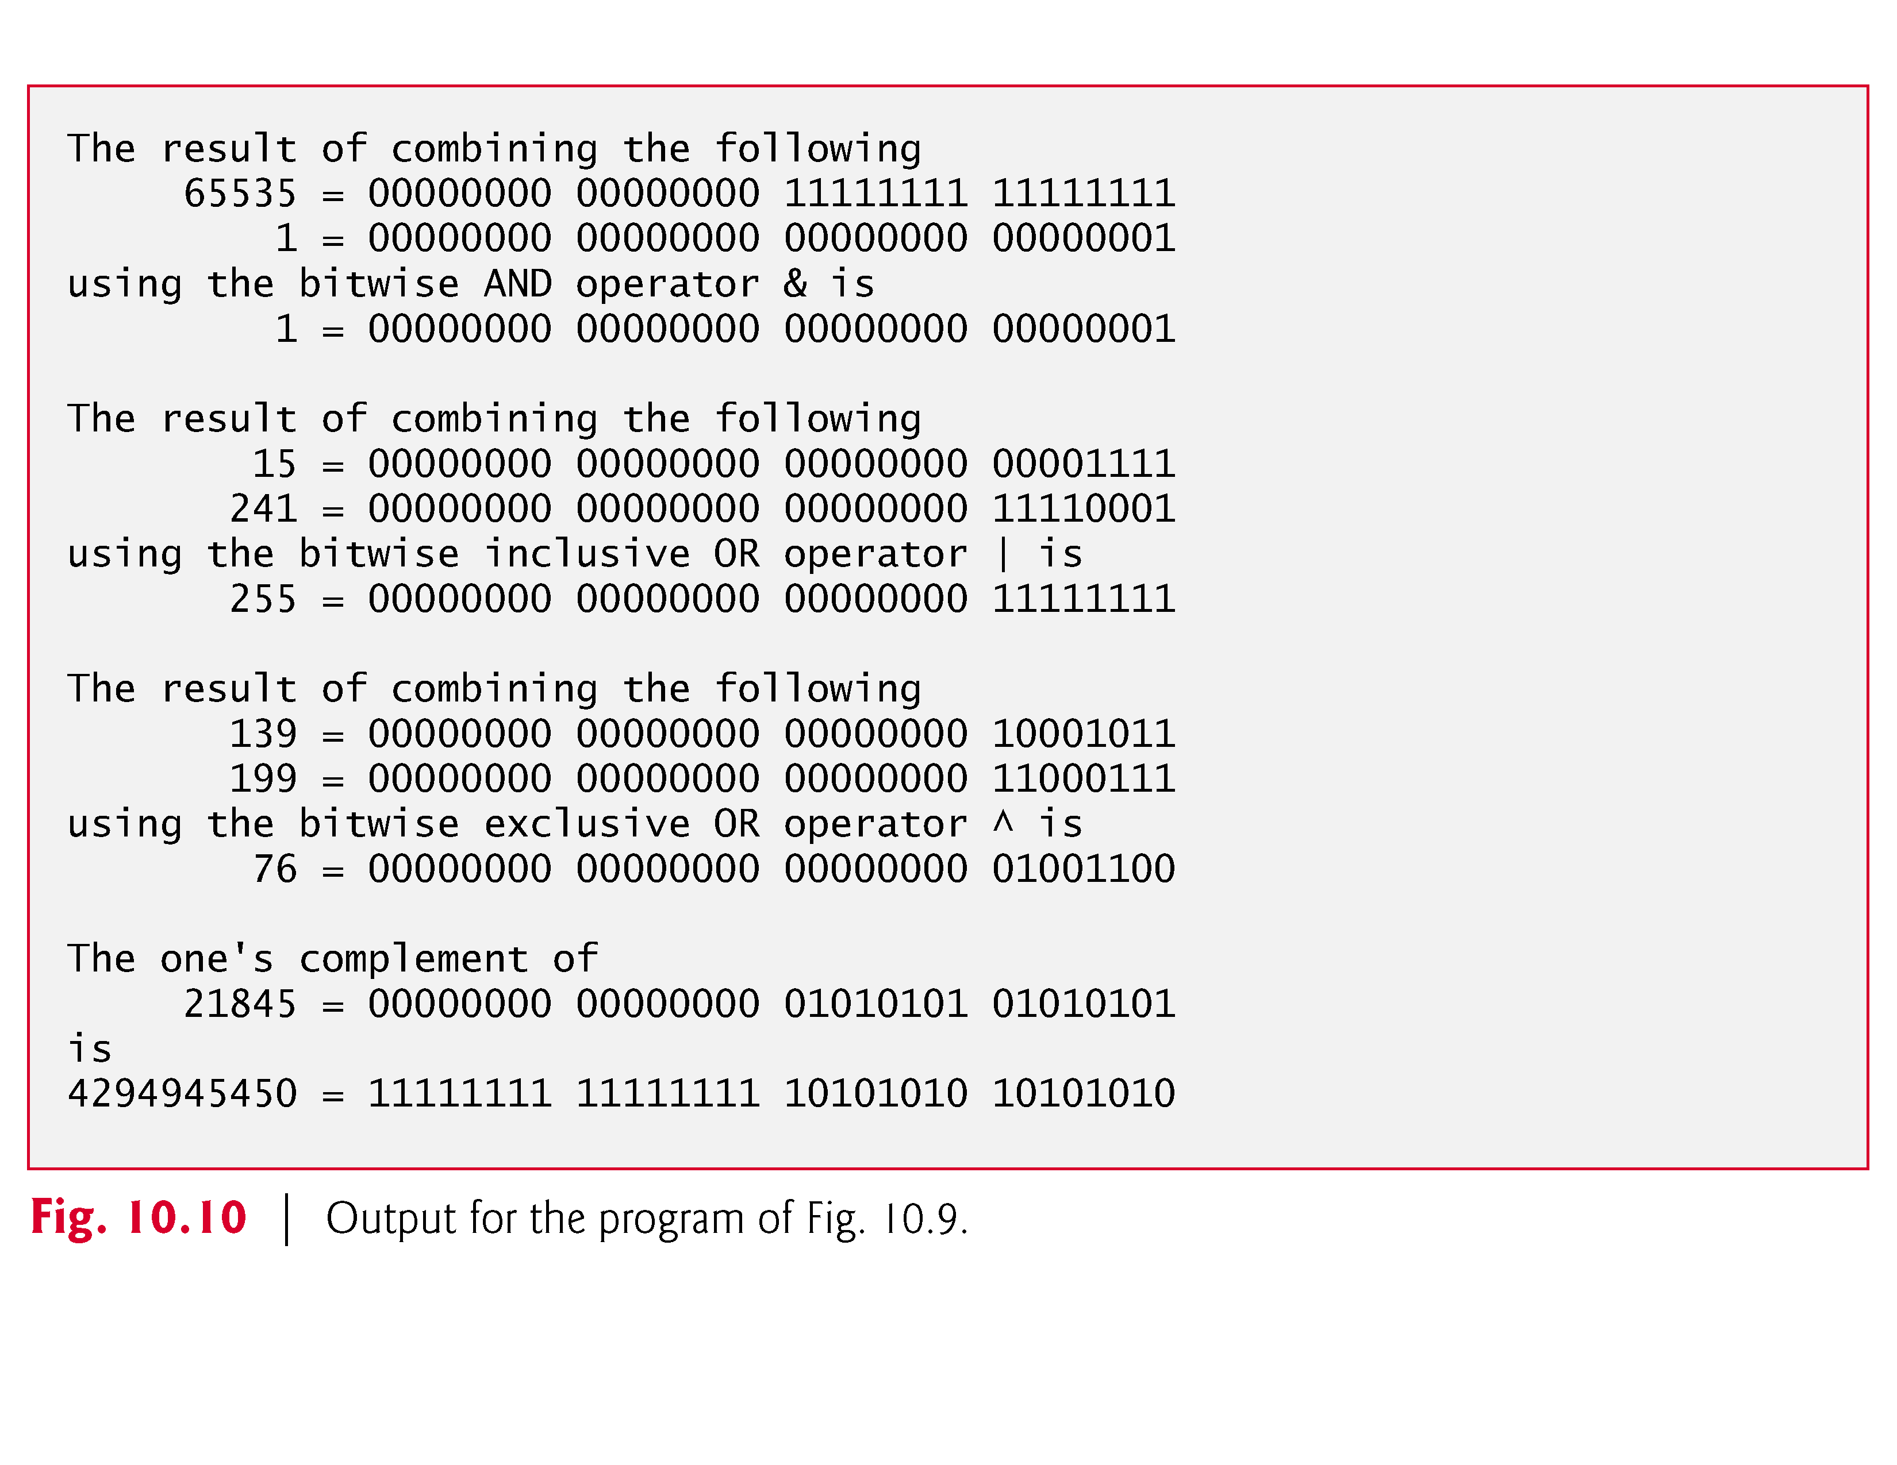

Slide 34
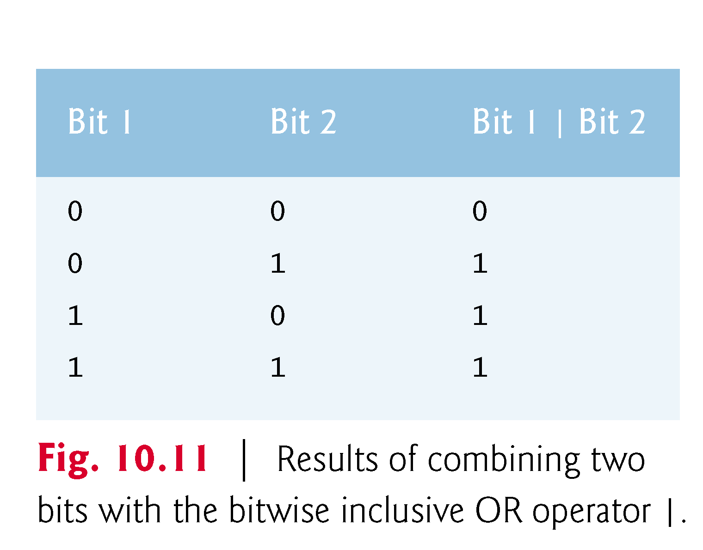
Bitwise Operators

Slide 35
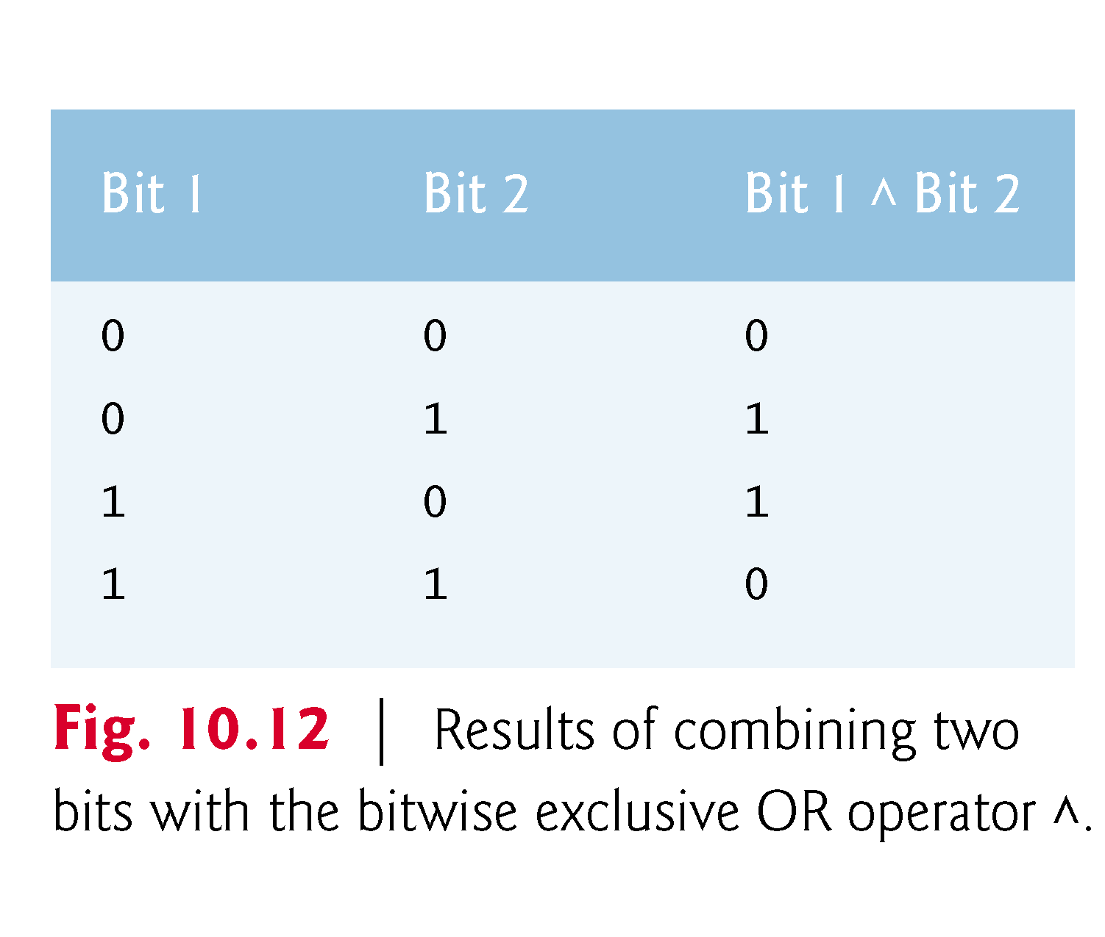
Bitwise Operators

Slide 36
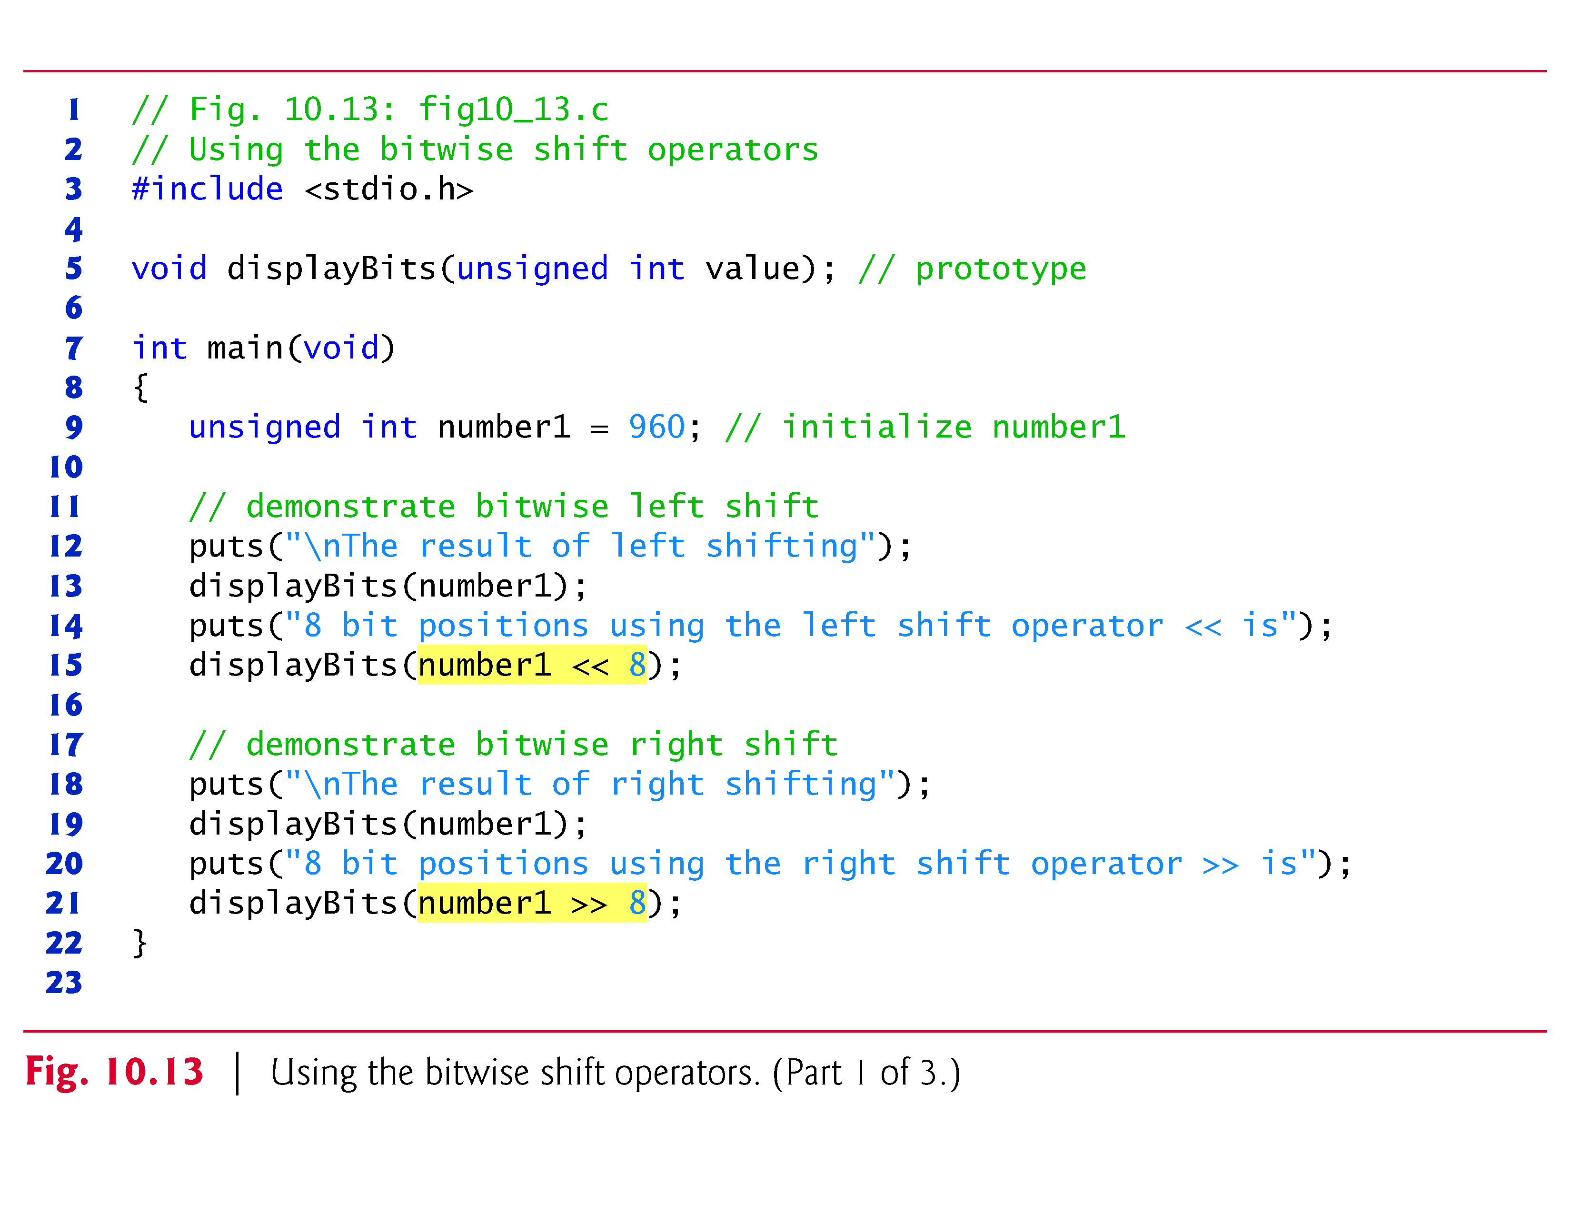
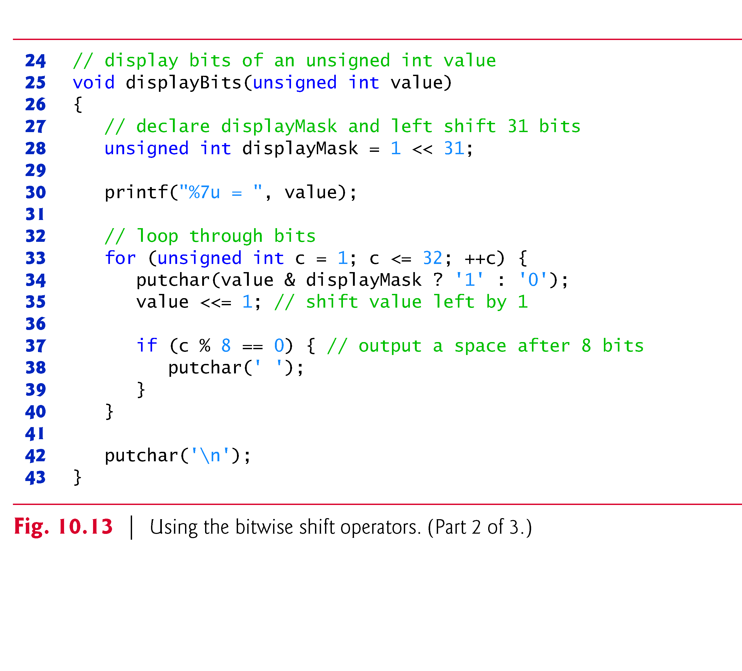
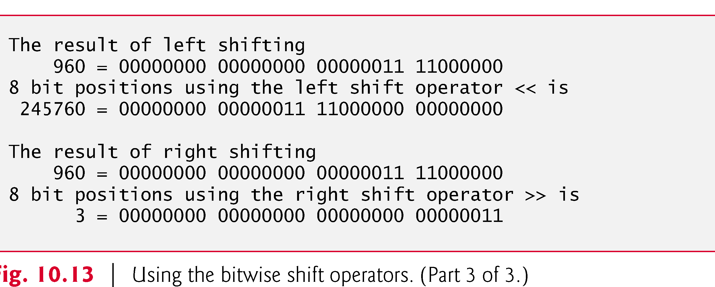

Slide 37
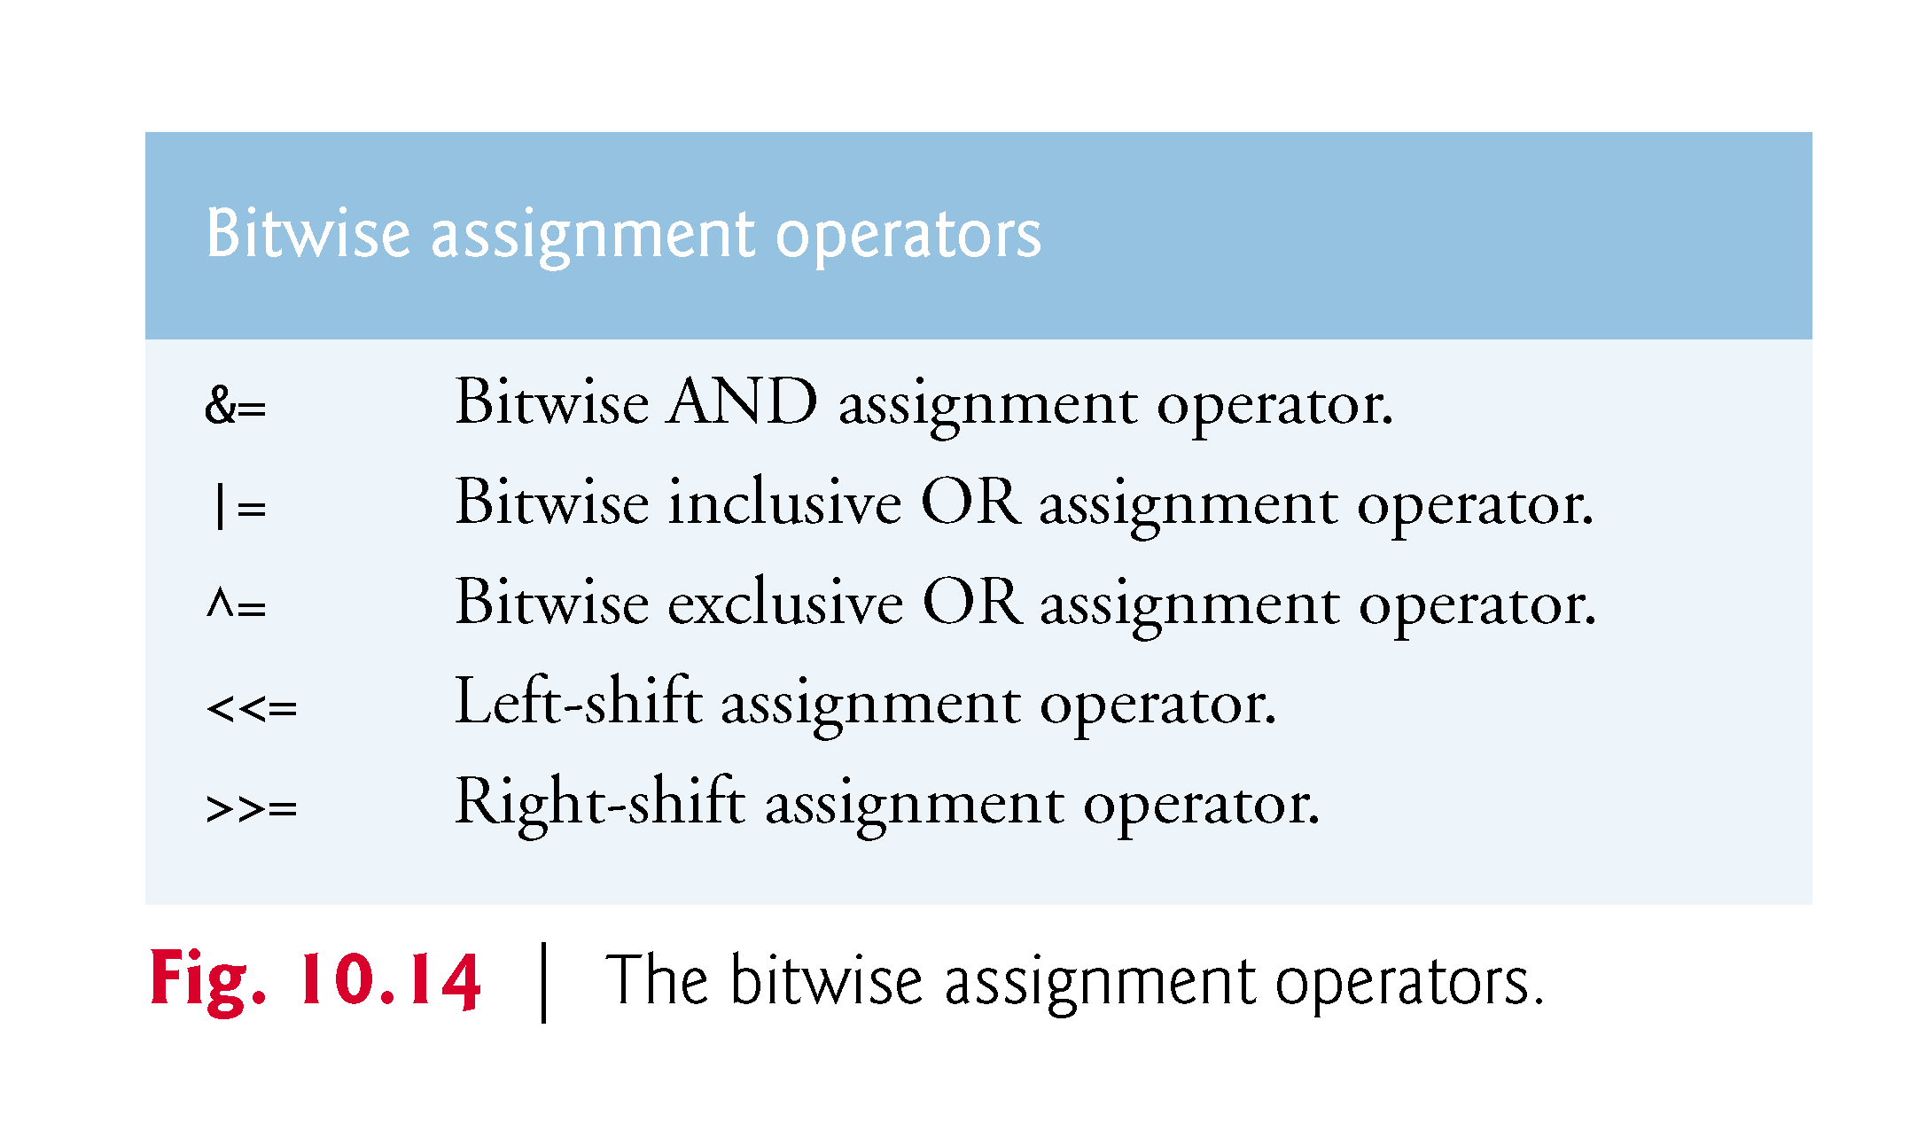
Bitwise Operators

Slide 38
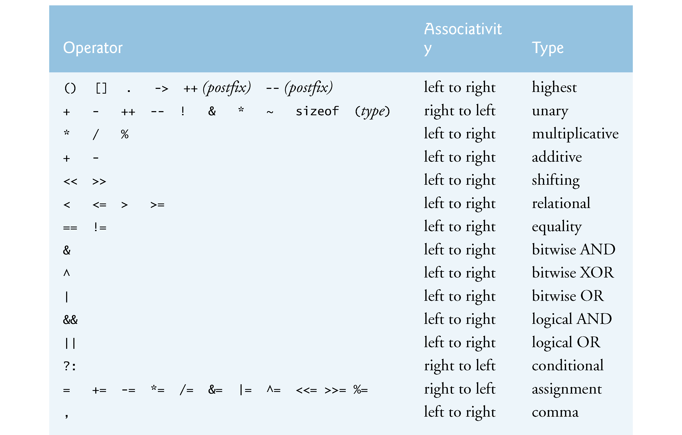

Slide 39
Bit Fields
Bit field
Member of a structure whose size (in bits) has been specified
Enable better memory utilization
Must be defined as int or unsigned
Cannot access individual bits
Defining bit fields
Follow unsigned or int member with a colon (:) and an integer constant representing the width of the field
Example:
struct BitCard {
unsigned face : 4;
unsigned suit : 2;
unsigned color : 1;
};

Slide 40
Bit Fields
Unnamed bit field
Field used as padding in the structure
Nothing may be stored in the bits
struct Example {
unsigned a : 13;
unsigned : 3;
unsigned b : 4;
}
Unnamed bit field with zero width aligns next bit field to a new storage unit boundary

Slide 41
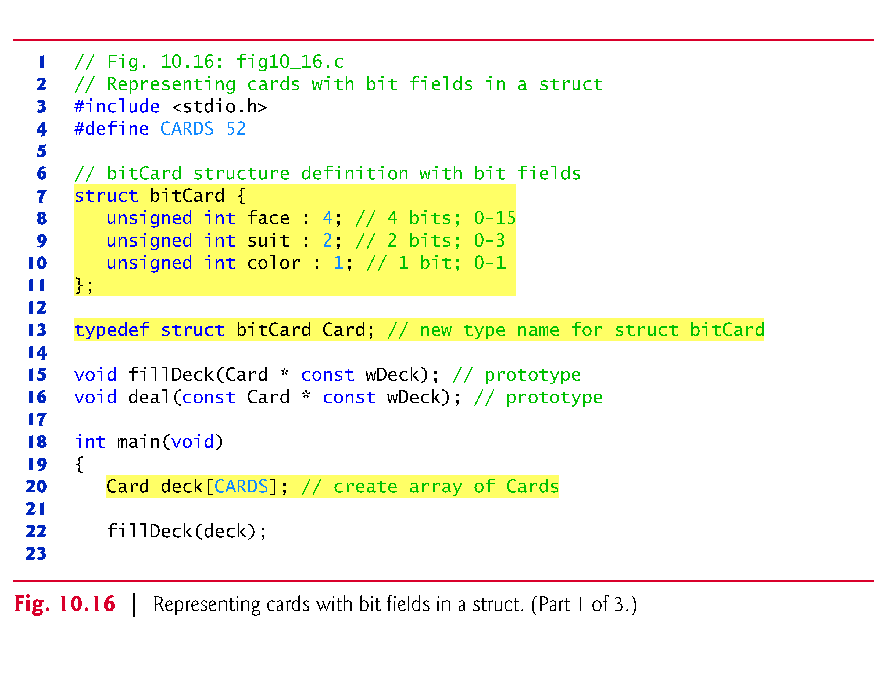

Slide 42
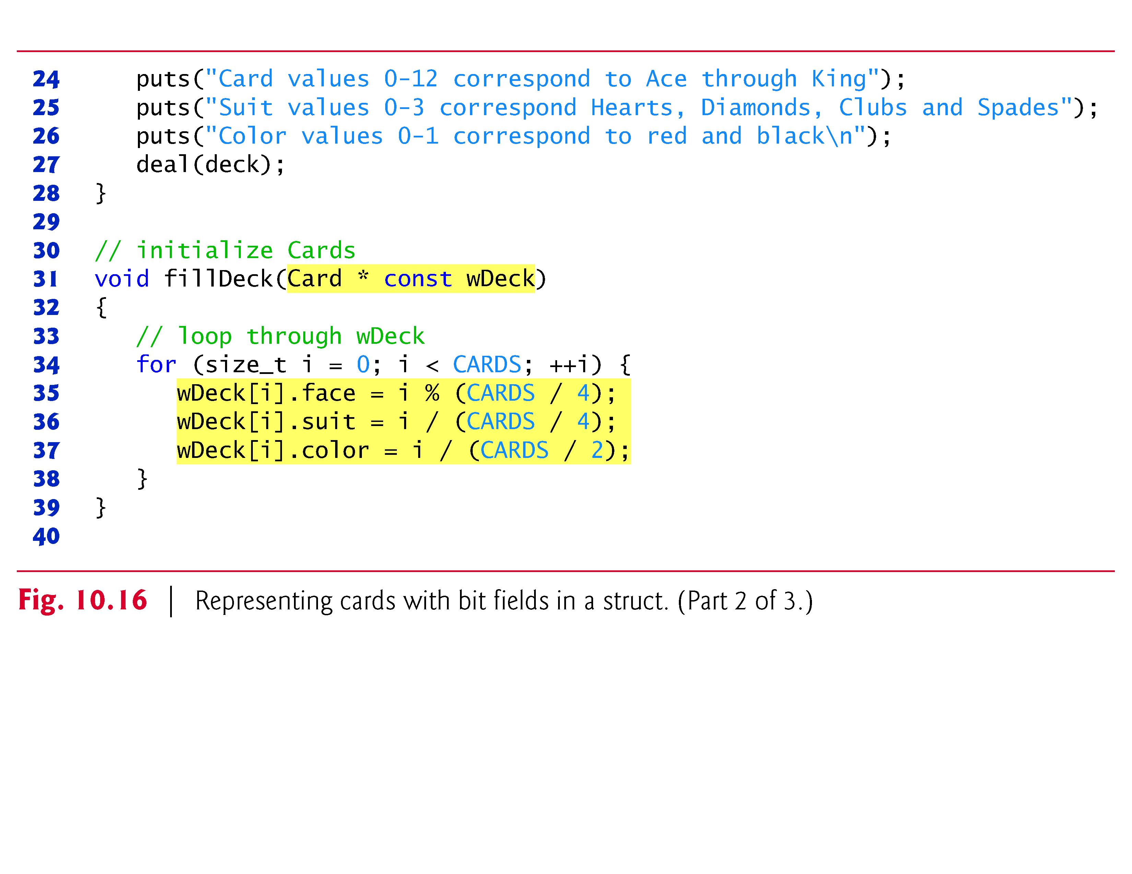

Slide 43
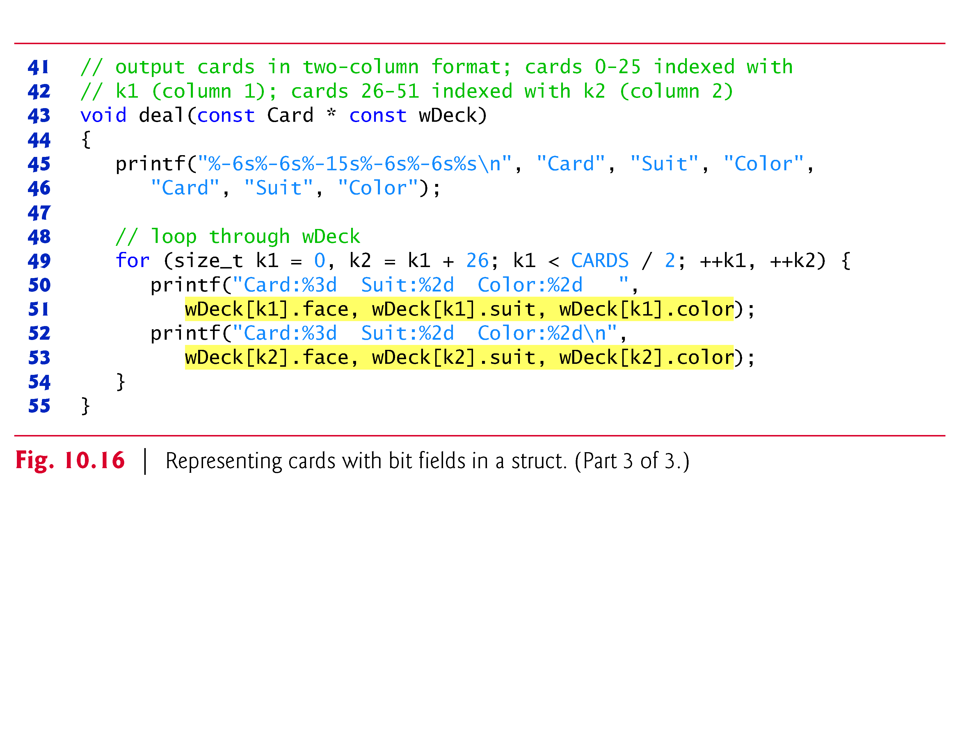

Slide 44
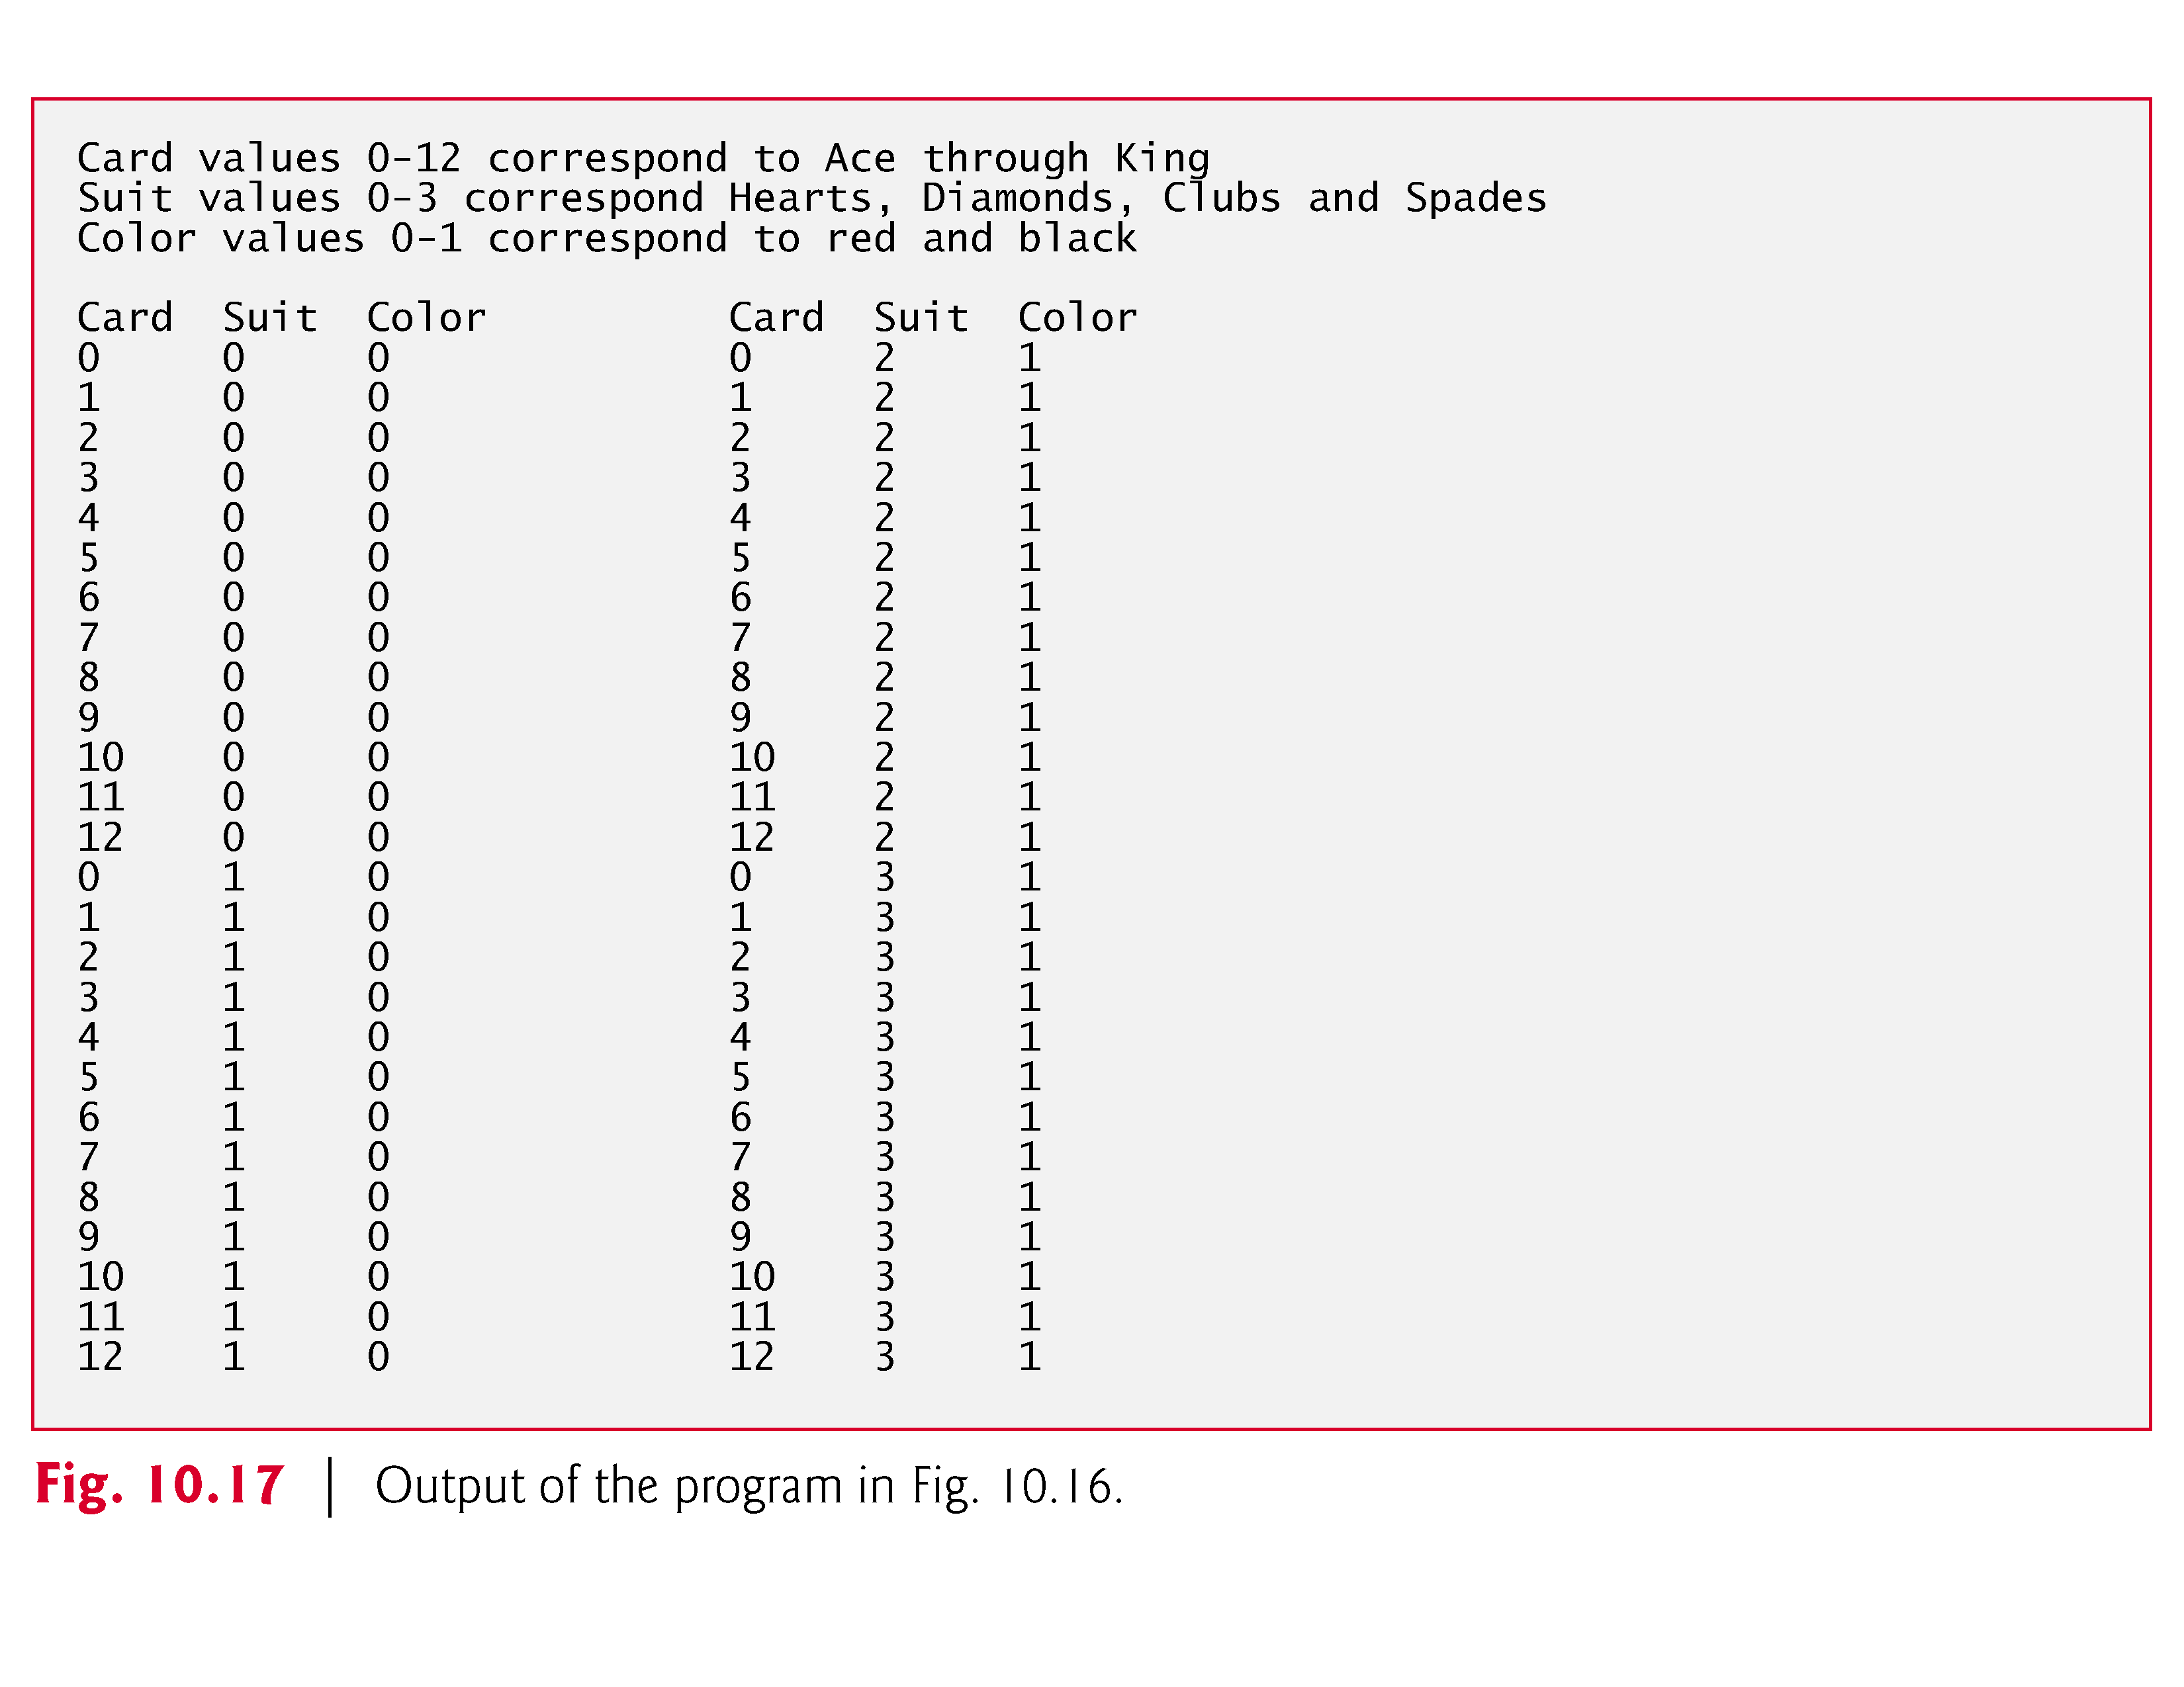

Slide 45
Enumeration Constants
Enumeration
Set of integer constants represented by identifiers
Enumeration constants are like symbolic constants whose values are automatically set
Values start at 0 and are incremented by 1
Values can be set explicitly with =
Need unique constant names
Example:
enum Months { JAN = 1, FEB, MAR, APR, MAY, JUN, JUL, AUG, SEP, OCT, NOV, DEC};
Creates a new type enum Months in which the identifiers are set to the integers 1 to 12
Enumeration variables can only assume their enumeration constant values (not the integer representations)

Slide 46
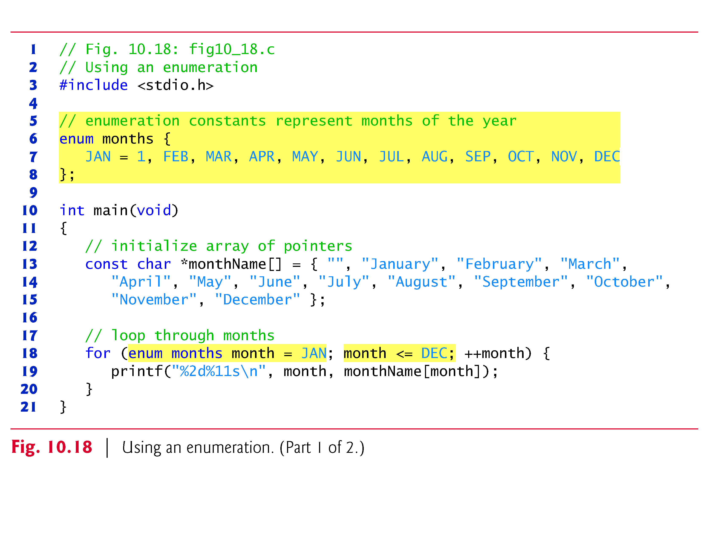
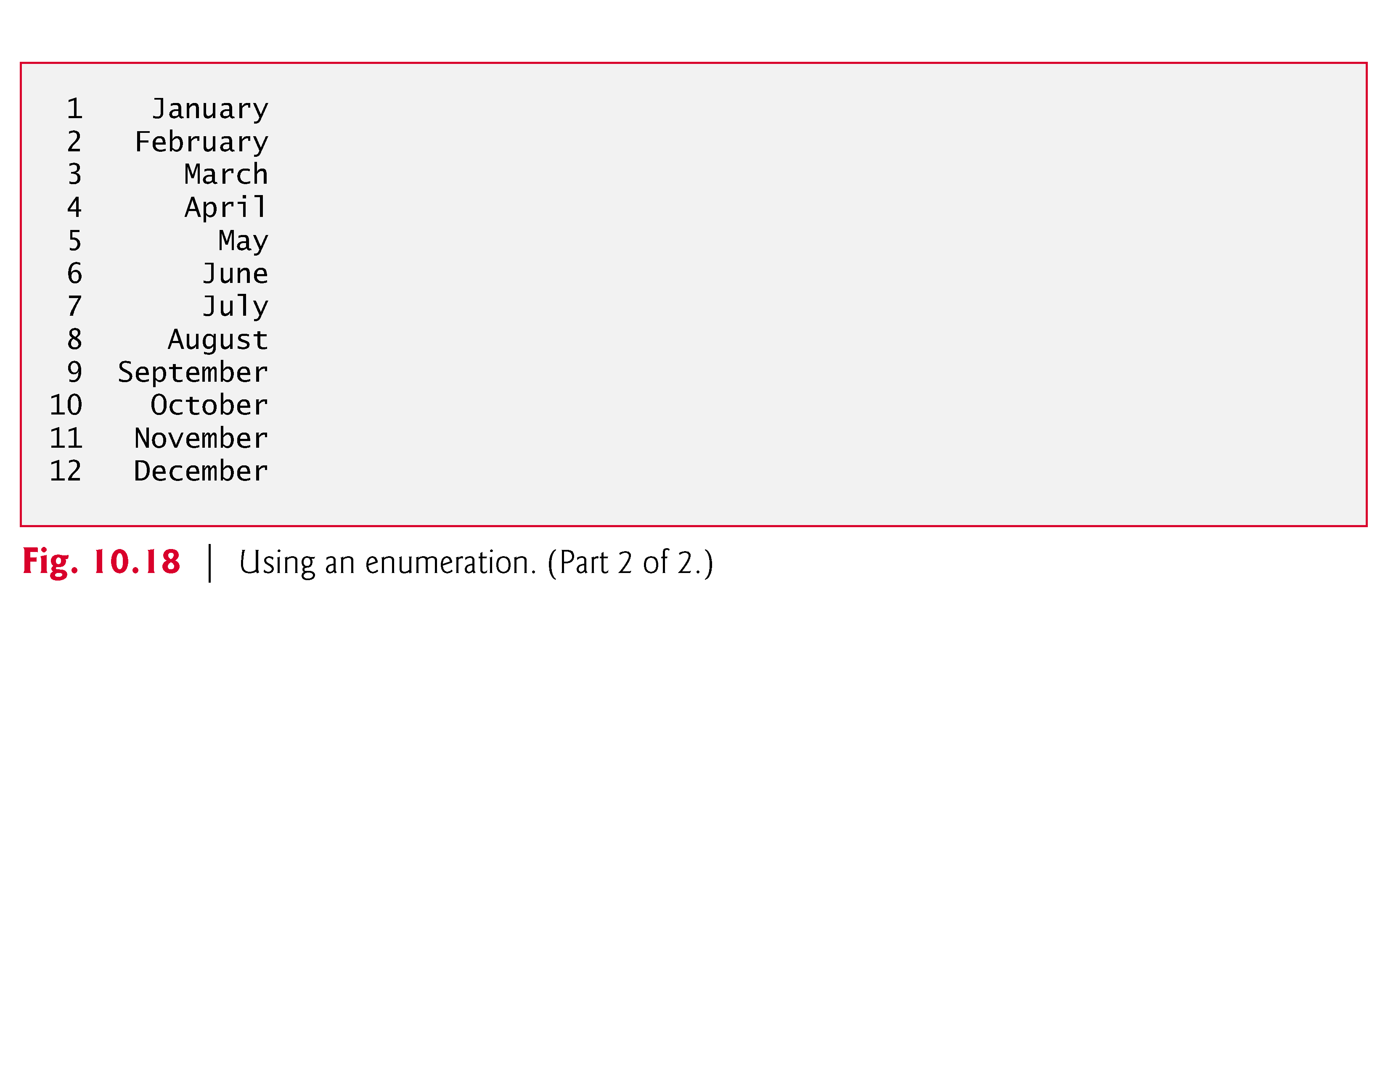

Slide 47
10.12 Anonymous Structures and Unions
C11 supports anonymous structs and unions that can be nested in named structs and unions
Members in a nested anonymous struct and union are considered to be members of the enclosing type and can be accessed directly through an object of the enclosing type
Example
struct MyStruct { int member1; int member2; struct { int nestedMember1; int nestedMember2; }; };
For a variable myStruct of type struct MyStruct, you can access the members as:
myStruct.member1 myStruct.member2 myStruct.nestedMember1 myStruct.nestedMember2

Slide 48
10.13 Secure C Programming
Various CERT guidelines and rules apply to this chapter’s topics. For more information on each, visit www.securecoding.cert.org.
struct
The boundary alignment requirements for struct members may result in extra bytes containing undefined data for each struct variable you create. Each of the following guidelines is related to this issue:

Slide 49
10.13 Secure C Programming (Cont.)
EXP03-C: Because of boundary alignment requirements, the size of a struct variable is not necessarily the sum of its members’ sizes. Always use sizeof to determine the number of bytes in a struct variable. As you’ll see, we use this technique to manipulate fixed-length records that are written to and read from files in Chapter 11, and to create so-called dynamic data structures in Chapter 12.
EXP04-C: struct variables cannot be compared for equality or inequality, because they might contain bytes of undefined data. Therefore, you must compare their individual members.

Slide 50
10.13 Secure C Programming (Cont.)
DCL39-C: In a struct variable, the undefined extra bytes could contain secure data—left over from prior use of those memory locations—that should not be accessible. This CERT guideline discusses compiler-specific mechanisms for packing the data to eliminate these extra bytes.
typedef
DCL05-C: Complex type declarations, such as those for function pointers can be difficult to read. You should use typedef to create self-documenting type names that make your programs more readable.

Slide 51
10.13 Secure C Programming (Cont.)
Bit Manipulation
INT02-C: As a result of the integer promotion rules (discussed in Section 5.6), performing bitwise operations on integer types smaller than int can lead to unexpected results. Explicit casts are required to ensure correct results.
INT13-C: Some bitwise operations on signed integer types are implementation defined—this means that the operations may have different results across C compilers. For this reason, unsigned integer types should be used with the bitwise operators.

Slide 52
10.13 Secure C Programming (Cont.)
EXP17-C: The logical operators && and || are frequently confused with the bitwise operators & and |, respectively. Using & and | in the condition of a conditional expression (?:) can lead to unexpected behavior, because the & and | operators do not use short-circuit evaluation.
enum
INT09-C: Allowing multiple enumeration constants to have the same value can result in difficult-to-find logic errors. In most cases, an enum’s enumeration constants should each have unique values to help prevent such logic errors

